Slide 1
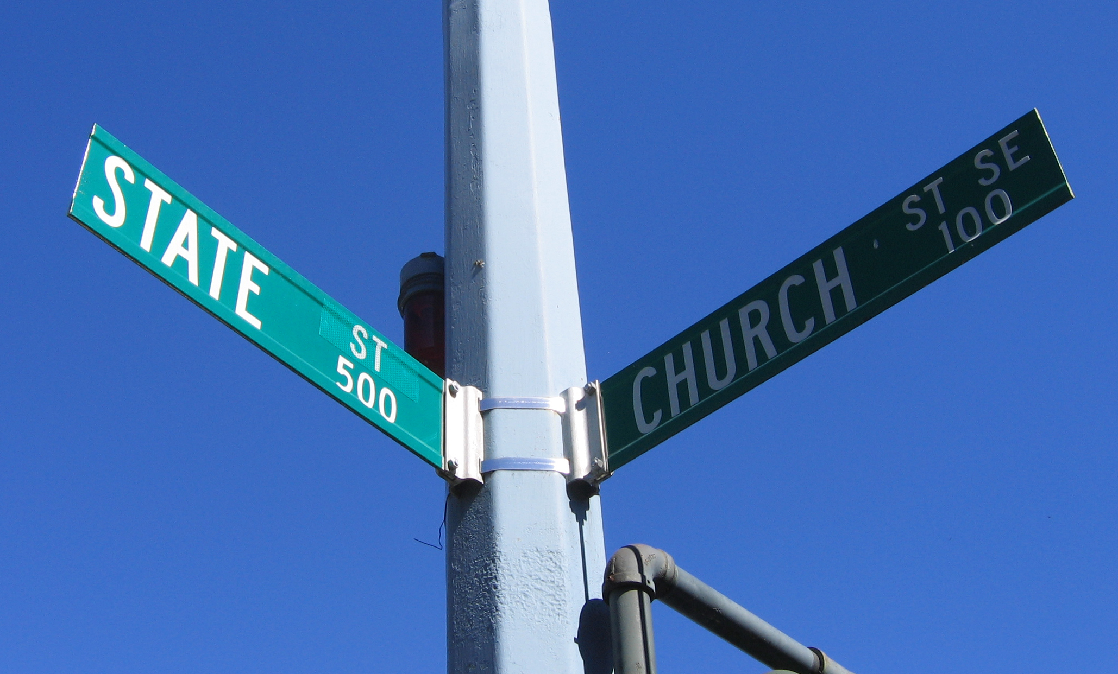
Wall of Separation

Slide 2
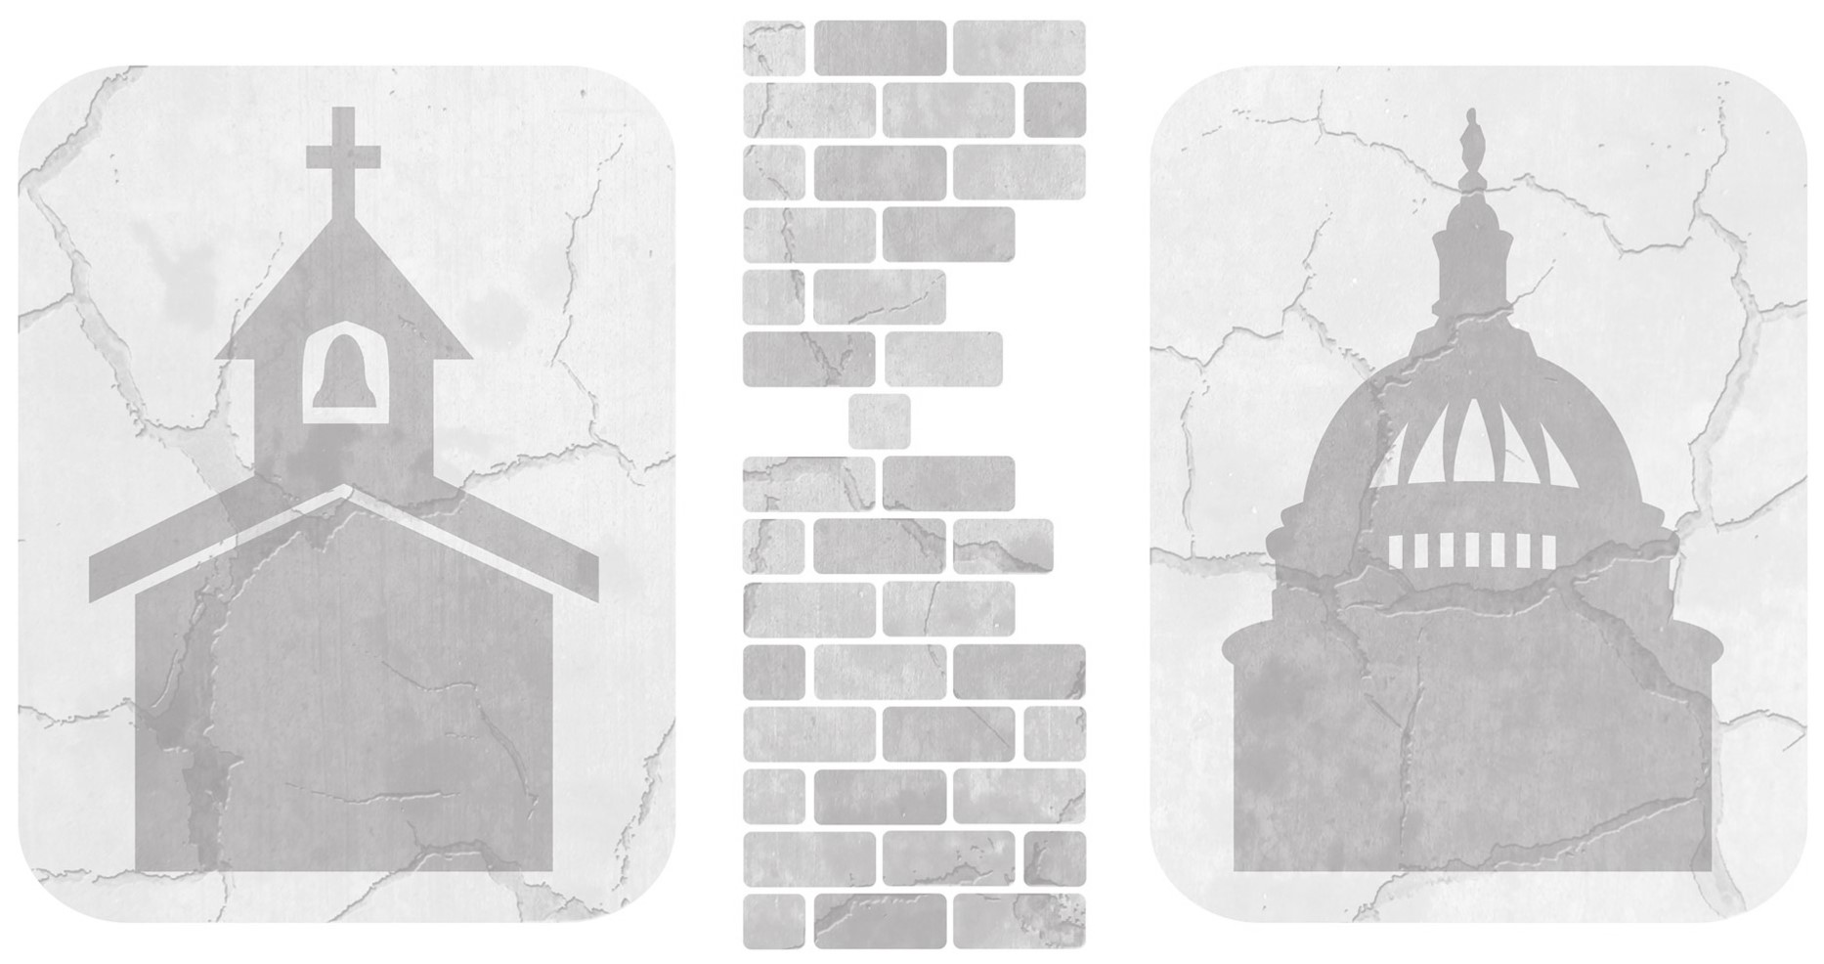
The United States is founded on laws, but it also stands on metaphors
In American life there is no more controversial metaphor than Jefferson’s “Wall of separation between church and state”
The metaphor was established not any founding documents, but in Jefferson’s January 1, 1802 letter to the Danbury Baptists

Slide 3
The Danbury Baptists lived in a state in which Congregationalism was the established church
Baptists in the early republic were separationists, much unlike today
Jefferson did, in fact, believe in God
  He famously created the Jefferson Bible, where he removed the supernatural qualities of Jesus from the Bible, and instead, focused on the model of Jesus as a moral teacher

Slide 4
Jefferson was a product of the Enlightenment, where he used rational and logical thought to fully discover the nature of God
The degree to which Jefferson was a deist is a subject of intense debate

Slide 5
Jefferson’s Letter to the Danbury Baptists was written to show his sympathy for their position, as the church opposed the establishment of an official church for the state of Connecticut
At this point in our nation’s history, the issue of whether a state could have an official religious connection was not settled

Slide 6
Since then this metaphor has dominated debates inside and outside the courtroom
Democrats used to stand with Jefferson and the Danbury Baptists
However, since the defeat of John Kerry to George W. Bush in 2004 the Democratic Party has gotten religion

Slide 7
In the 2008 election season Democratic presidential candidates gathered for debates on questions of faith and morals
  Barack Obama referred to himself as a “Committed Christian”

