Slide 1
The Dharma

Slide 2
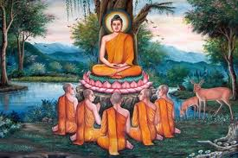
Buddhism is often described as nontheistic
No personal God; do not worship the Buddha
Revere the Buddha’s teachings—a raft to take followers to the farther shore, nirvana

Slide 3
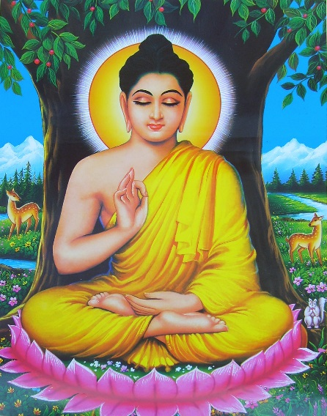
Four Noble Truths
There is suffering in the worldeto live is to suffer (Dukkha)
The Buddha found this out when he was young and experienced suffering and death in others

Slide 4
The cause of suffering is self-centered desire and attachments (Tanha)
The solution is to eliminate desire and attachments (Nirvana = “extinction”)
To reach nirvana, one must follow the Eightfold Path

Slide 5
The Noble Eightfold Path to Liberation

Slide 6
Right Understanding: realize and understand the Four Noble Truths
Right Thought or Motives: uncover any unwholesome roots in one’s thinking, eliminate self-­centeredness
Right Speech: abstain from lying, gossiping, speaking harshly, divisive speech

Slide 7
Right Action: observe the Five Precepts, namely to avoid destroying life, stealing, sexual misconduct, lying, and intoxicants
Right Livelihood: make a living without violating the Five Precepts

Slide 8
Right Effort: eliminate impurities of the mind and cultivate wholesome actions
Right Mindfulness: be aware in every moment, discipline the mind
Right Meditation: quiet the mind through mental discipline

Slide 9
The Wheel of Birth and Death
No eternal, independently existing soul to be reborn
Central cause is karma
3 root afflictions: greed, hate, and delusion
Cultivating non-greed, non-hate, and non-delusion act as causes to leave the circle of birth and death

Slide 10
Eightfold Path
Nirvana
Union with the ultimate spiritual reality
Escape from the cycle of rebirth

Slide 11
Nirvana
Arhat who extinguishes all desires - reborn doesn't apply
Response to disciple: You ought to be bewildered - this is "profound, recondite, hard to comprehend, rare, excellent, beyond dialectic, subtle, only to be understood by the wise"

Slide 12
Supra-sonic?
"blow out/extinguish" boundaries of finite self, left w/ boundless life
Far transcends the power of words - individual awareness is eclipsed in the blazing light of total awareness like a star at sunrise

Slide 13
Spiritual freedom brings largeness of life - Buddha “embodied more of reality”
If increased freedom brings increased being, total freedom brings BEING itself

