Slide 1
Religious Responses

Slide 2
Absolutist and Liberal Interpretations
Orthodox
strictly follow established practices, laws, and creeds
Absolutist
resist contemporary influences and affirm the historical core of their religion

Slide 3
Fundamentalist
often (but misleadingly) applied to a selective insistence on parts of a religious tradition
Liberal
more flexible approach to religious tradition

Slide 4
Encounter between Science and Religion
Science, like religion, searches for universal principles to explain reality
Early scientists placed greater emphasis on rational knowledge

Slide 5
Recently, scientists have sought to understand religious belief
Conflict between science and religion is exemplified in the opposing views of creationism and Darwinism

Slide 6
Current Dialogue Between Science and Religion
Conflict model
Science and religion deal with separate realms
A dialogue in which scientists and religious believers can find common ground
Integration, in which science and religion overlap

Slide 7
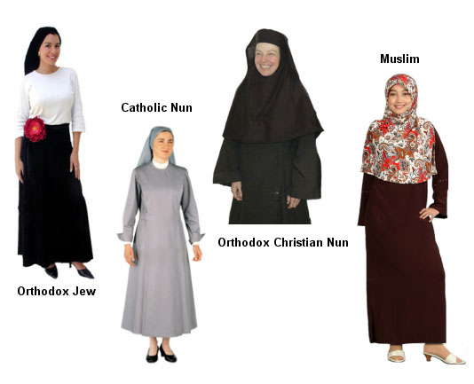
Women in Religions
Most institutionalized religions are patriarchal
This situation is being widely challenged by the contemporary feminist movement

Slide 8
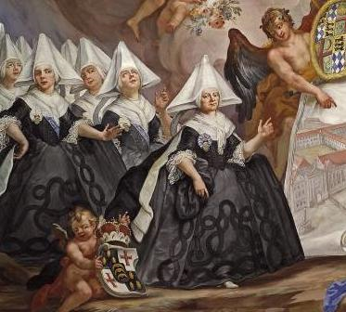
Many women are deeply concerned about violence, poverty, ecological disaster and are insisting that religions be actively engaged in these issues

Slide 9
Negative Aspects of Organized Religions
May split rather than unify humanity
May devote more energy to preserving the outer, institutional form of the religion than its inner spirit

Slide 10
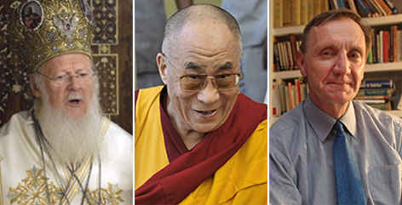
Those in religious power have the ability to dominate and manipulate the faithful; people may put their faith in unethical or misguided spiritual leaders

Slide 11
May lead to an exaggeration of guilt in people with perfectionist or paranoid tendencies; may become a form of escapism; may be psychologically harmful to some

Slide 12
A potential center for political power, and may be used as a rallying point for wars against other peoples or nations

Slide 13
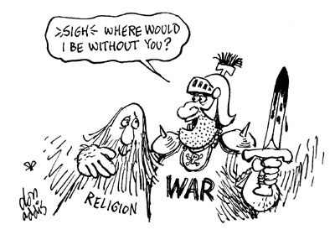

Slide 14
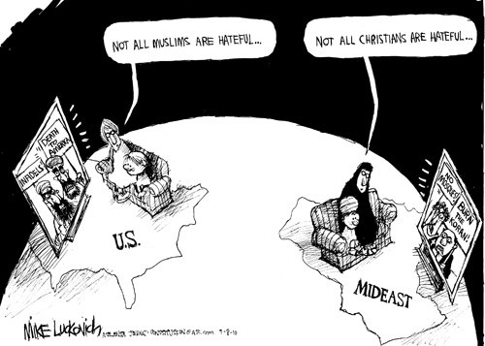

Slide 17
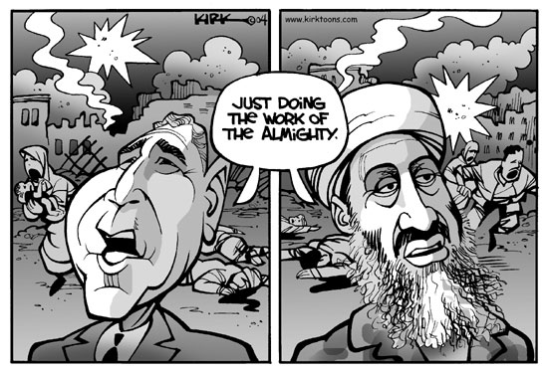

Slide 18
