Slide 1
Physical & Metaphysical Elements

Slide 2
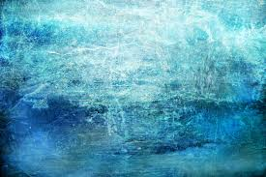
Philosophical & Metaphysical Origins
Brahmanic tradition traces back to the Vedic age, thousands of years ago
The Indus Valley Civilization
history and precise dating of this period is controversial

Slide 3
Sacred Texts

Slide 4
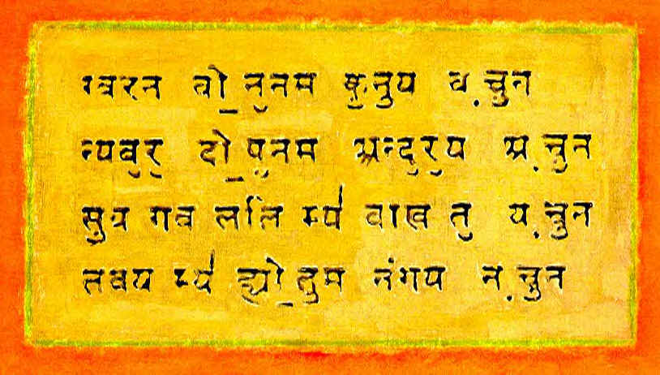
Originally, all the Hindu religious texts were written in Sanskrit
Sanskrit is considered a perfect sacred language although it is not spoken today
Sanskrit Text

Slide 5
Sanskrit is related to other Indo-European languages such as Greek and Latin
Look at these similarities to Romance languages:
“father” “mother”
Sanskrit
French
Spanish
pitr
pere
padre
matr
mere
madre

Slide 6
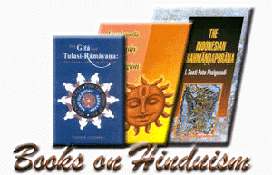
As a religion, Hinduism produced many Sanskrit texts
The four main groups are:
the Vedas
the Upanishads
two epics
and the Sutras

Slide 7
The Vedas
The Vedas are the earliest texts which exist in Hinduism
There are four of them: Rig, Sama, Yajur, and Atharva
They are collectively referred to as Sruti, which means “that which is heard”
The oldest is the Rig Veda

Slide 8
Originally, the Vedas were oral literature
All 1,028 hymns of the Rig Veda were memorized by the keepers of the sacred knowledge
The Rig Veda is the most important, with the others having come later and are based upon it

Slide 9
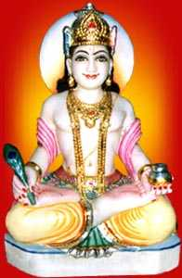
Veda translates from Sanskrit as “knowledge” or “wisdom.” The Vedas are considered by Hindus to be revealed literature, having originated with the gods whose praise they sing

Slide 10
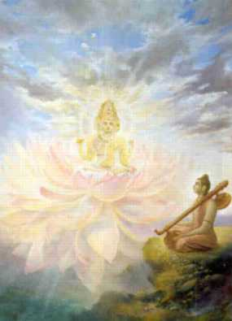
The Vedas represent the spiritual experiences of the Rishis or wise men
The Rishi is only a medium or an agent that transmits to people the spiritual experiences which he received
Lord Brahma, the Creator, imparted divine knowledge to the Rishis and thus into the Vedas
Brahma and a Rishi

Slide 11
The Vedas teach the belief of one supreme God, Brahman
Brahman’s attributes are represented by the three personified powers of creation, preservation, and destruction, which under the respective names of Brahma, Vishnu, and Shiva, form the triad of principal Hindu gods

Slide 12
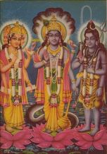
Brahma, Vishnu, and Shiva

Slide 13
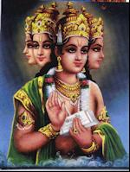
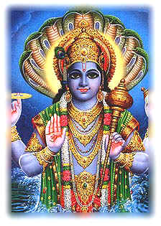
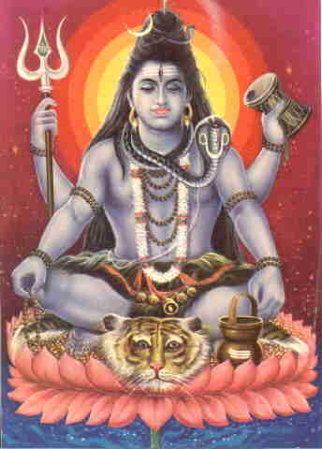
Brahma’s four faces represent the sacred knowledge in the four vedas.
Vishnu comes to earth to aid people. His most famous form is Krishna
Lord Shiva is also referred to as a goddess in Hinduism
Creation
Preservation
Destruction

Slide 14
The Upanishads
The Upanishads were recorded by different authors between 1000 and 600 BCE
In Sanskrit, Upanishad means “to sit nearby”
This refers to sitting near a teacher and learning from him or her

Slide 15
The Upanishads are considered the final stage of development of the Vedas
The Upanishads often discuss a single, complicated subject but do so by downplaying the importance of the gods and focusing on the importance of Brahman, the one true God

Slide 16
The Upanishads deal with questions of ultimate reality, like “Who am I really?” It is believed that people in deep meditation reach a state of pure consciousness, called Atman
It is further believed that Atman, pure consciousness, is also Brahman

Slide 17
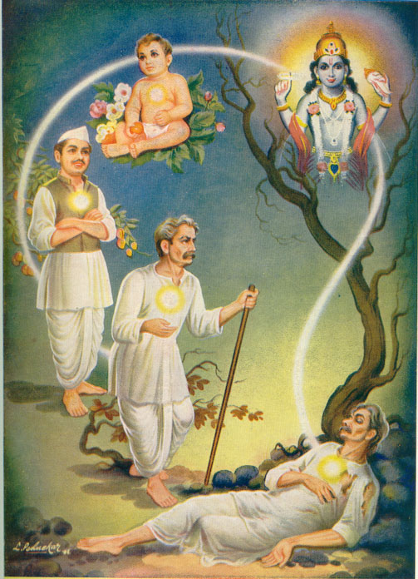
The Upanishads also profess the belief in samsara, the idea that the soul is reborn countless times until it reaches liberation and is born no more. Liberation happens when the soul is unified with Brahman.
Samsara, or reincarnation

Slide 18
Since the Upanishads do not promote the importance of the Gods in the Vedas, they were viewed as subversive and dangerous for a long time
They were often read in secrecy and shared only among people who felt that the subtle nature of the texts could be appreciated

Slide 19
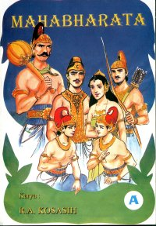
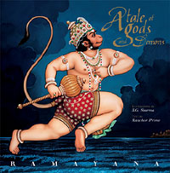
Epics
There are 2 great Hindu epics:
the Mahabharata
the Ramayana

Slide 20
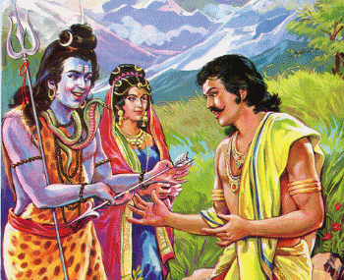
The Mahabharata is the world’s longest epic
It was written sometime between 200 BCE and 200 CE
It is still memorized and recited in villages across India
Arjuna receives weapons for the battle

Slide 21
The introduction to the Mahabharata contains the words:
"This is a holy textbook of morality, the best textbook for practical life as well as a textbook of redemption… Whoever has heard this story once will never find anything worth listening to again… What is not found here is not to be found anywhere in the world."

Slide 22
The Mahabharata is the story of a dispute between two branches of a family, the Pandavas and the Kauravas
Each want to rule the kingdom
The story is meant to provide a guide for living a righteous and correct life

Slide 23
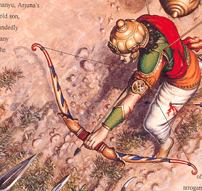
Arjuna in battle

Slide 24
Sutras
Sutras were some of the last sacred texts to be produced through Hinduism
They are commentaries that pertain to the rules of ritual, law, custom, and behavior.

Slide 25
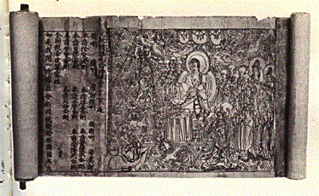
Two of the more famous sutras deal with:
Yoga
eroticism (sexual desire)

Slide 26
In Hindu belief, sexual activity is a proper goal of married couples
The Kama Sutra is a commentary on this and other aspects of eroticism
Furthermore, the Kama Sutra is a metaphor for warfare and even a business guide for courtesans

Slide 27
As you recall, Sanskrit is considered a perfect sacred language
When Sanskrit was spoken and the sacred texts recited, every syllable, every accent, and every pause had to be correct; otherwise, when the text was recited, the sacred power of the words would be lost

Slide 28
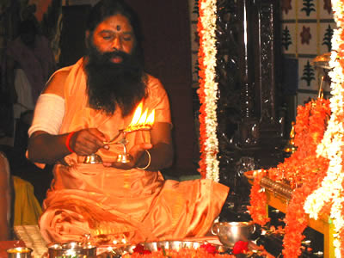
Sri Swamiji performs the Festival of Lights ceremony

Slide 29
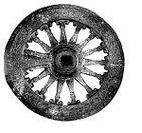
Reincarnation
Samsara is the wheel of rebirth which means the soul is reborn from one life form to another
People may be reincarnated at a higher or lower level of existence depending on their karma from their present life

Slide 30
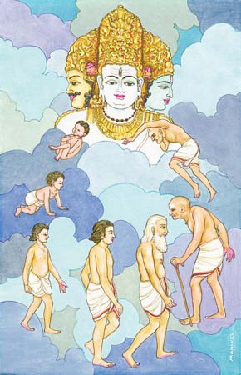
People may be reborn as plants or animals or they may be elevated to a higher caste as a human
Death is not final for Hindus as they expect to be reborn many times

Slide 31
Karma & Dharma
Karma: “action” or “deeds”
Every action produces a Justified effect based on its moral worthiness
Karma determines all the particular circumstances and Situations of one’s life

Slide 32
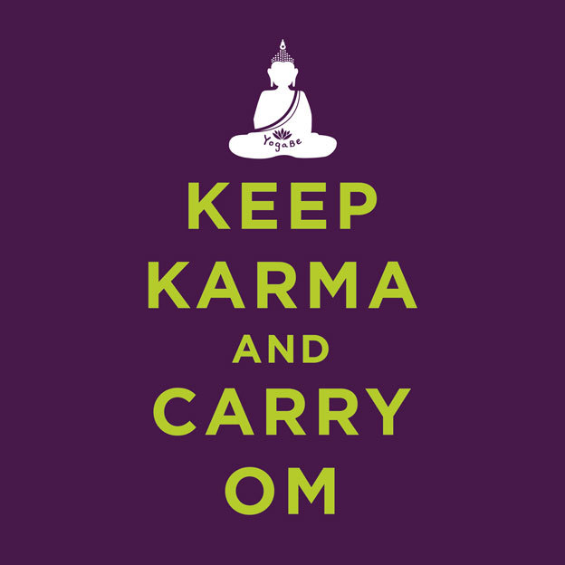

Slide 33
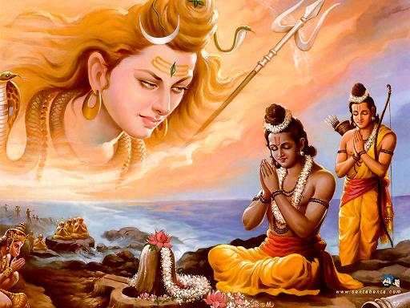
Dharma: ethical duty based on the divine order of reality
the word is the closest equivalent to “religion”

