Slide 1
Split Congress – 2019-2021
As of January, 2019, there is a Republican majority in the Senate and a Democrat majority in the House, with a Republican president
The political landscape of this country will change dramatically as a result

Slide 2
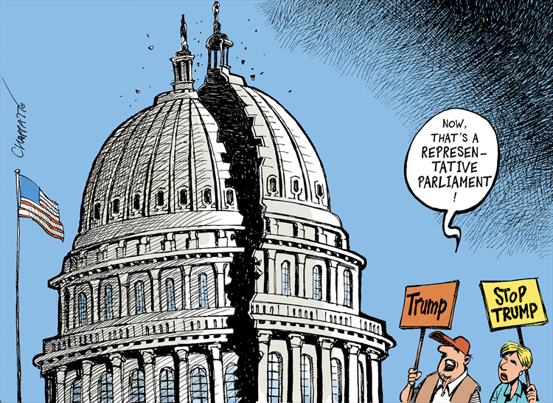

Slide 3
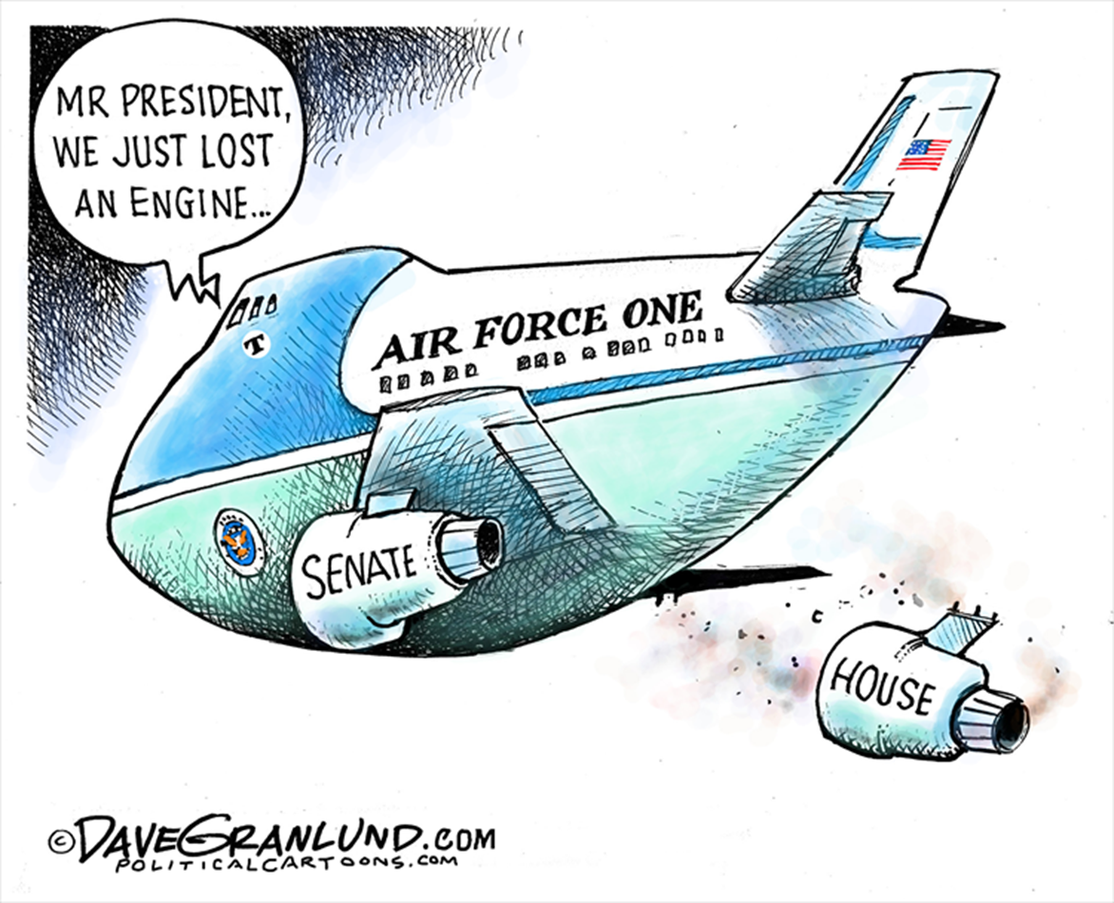

Slide 5
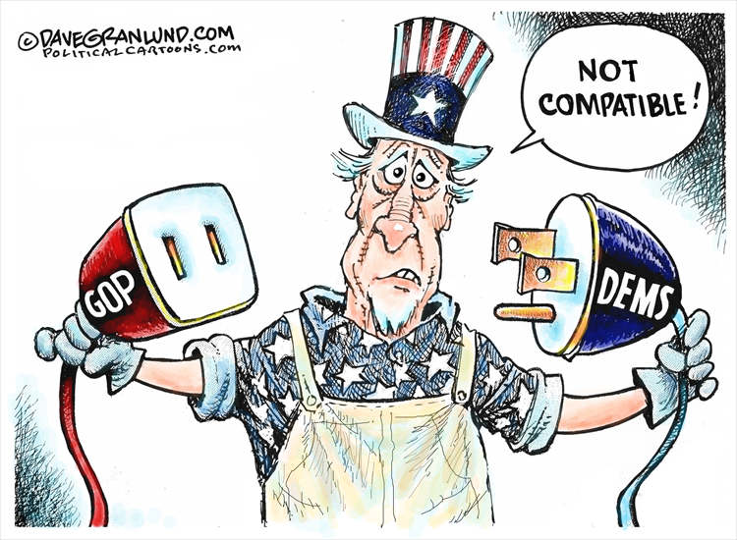

Slide 6
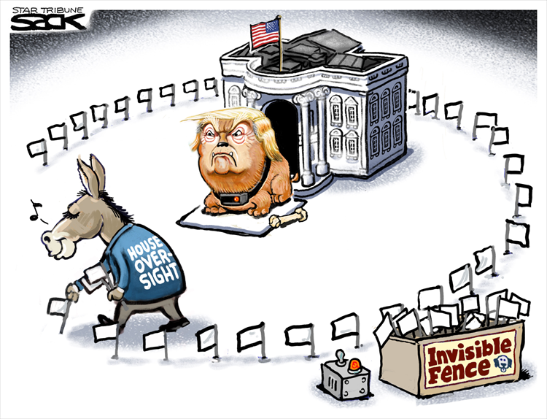

Slide 7
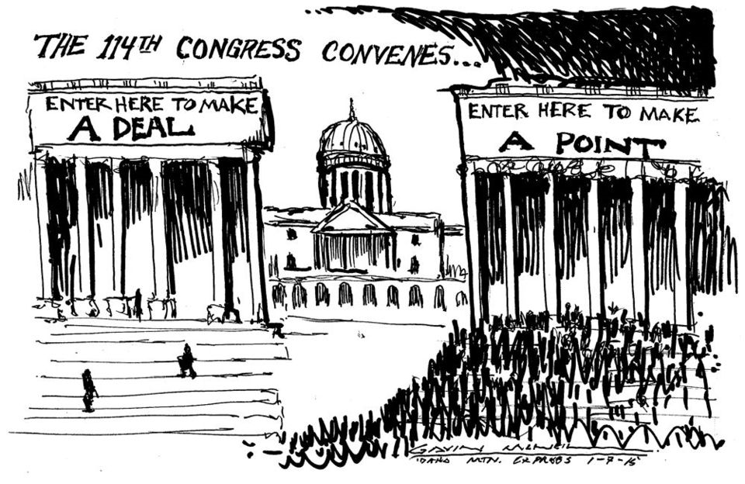

Slide 8
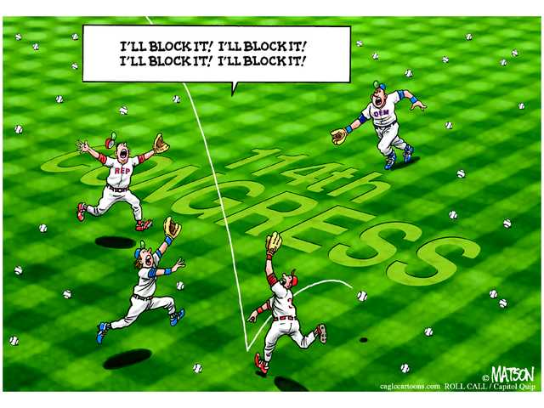

Slide 9
Split Congress – 2019-2021
What are the artists implying is the relationship between Congress and the Prez? Explain
What are the artists conveying about the role of party politics in Congress? Explain
Based on the cartoons, what can you predict about the next phase of Donald Trump’s term? Explain

