Slide 1
Trump & COVID 19
Executive leadership organizes our responses to a crisis, enabling effective action and inspiring heroic contributions. As citizens, we have every right to expect that executive branch would be taking necessary steps in mobilizing for COVID-19 as a looming natural disaster. State and local leaders have implemented unprecedented actions to slow the spread of COVID-19 and prepare the health care system, including “stay at home” orders and the rapid addition of hospital capacity. Effective action requires clear, consistent communication dictated by public health and science, not public relations. All levels of government must work together seamlessly, driven by the mission, not worries about bureaucratic turf. Action must be immediate and overwhelming.

Slide 2
View the political cartoons on the following slides and then answer the questions at the end

Slide 3
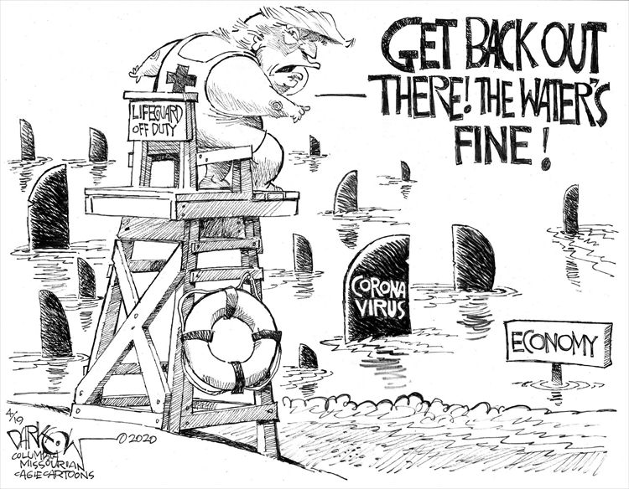

Slide 4
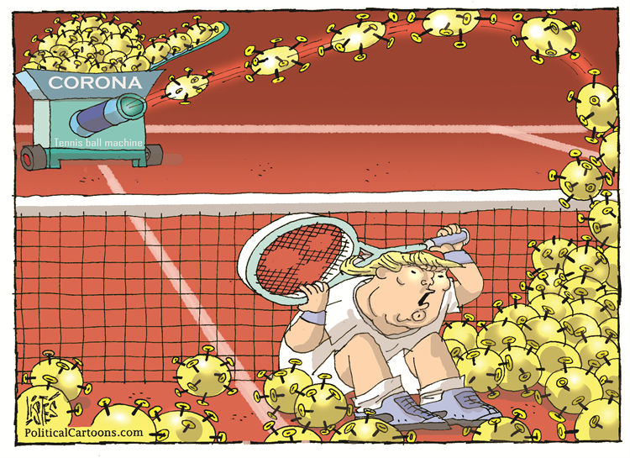

Slide 5
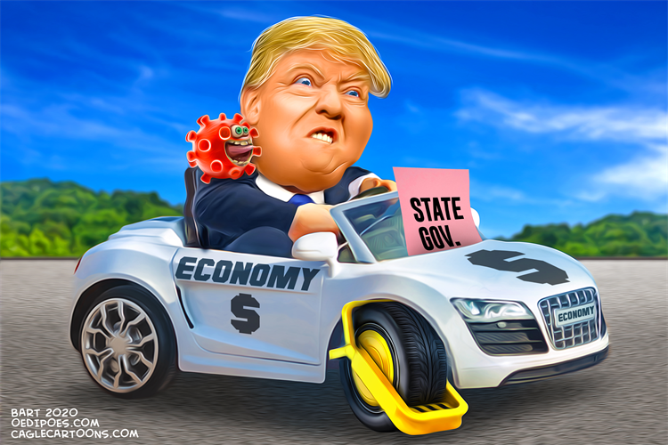

Slide 6
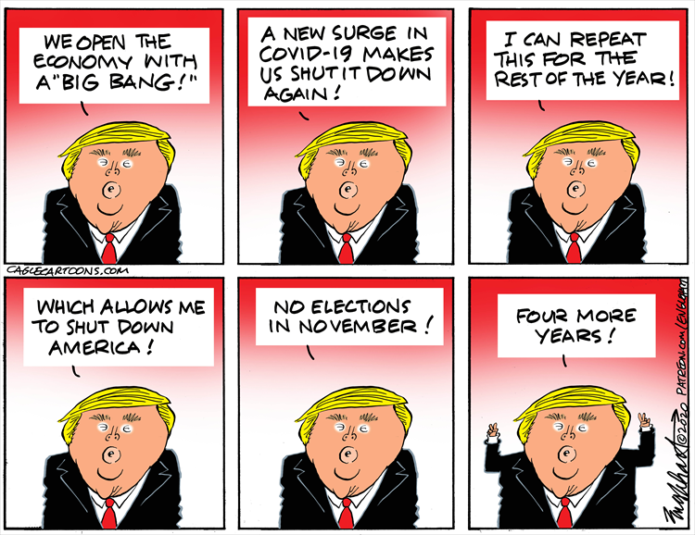

Slide 7
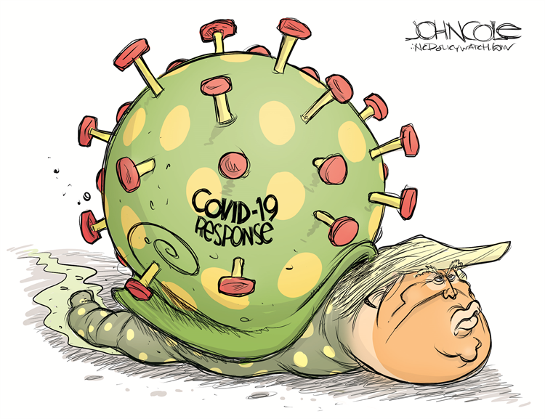

Slide 8
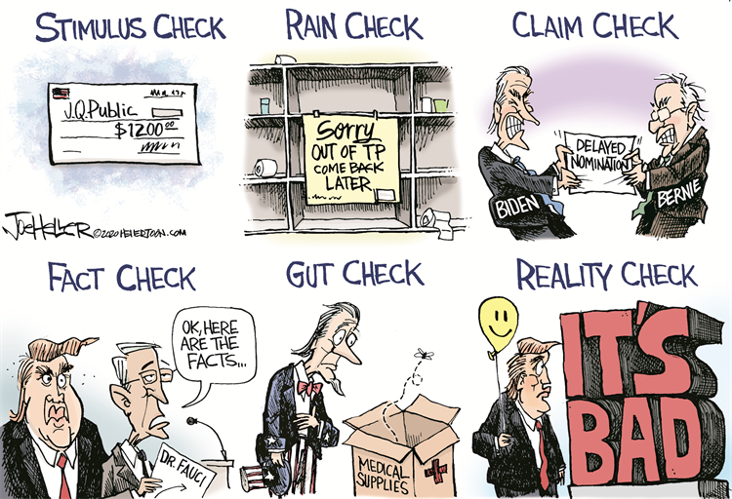

Slide 9
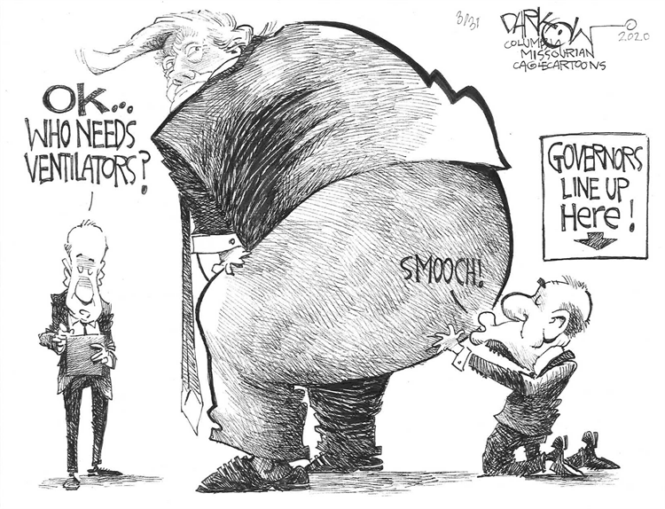

Slide 10
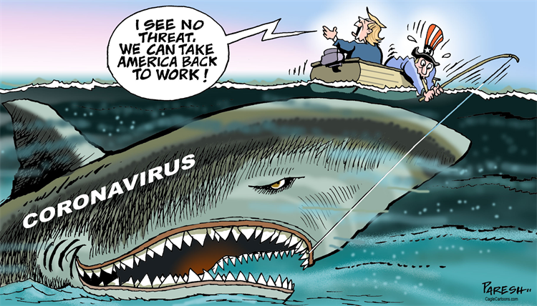

Slide 11
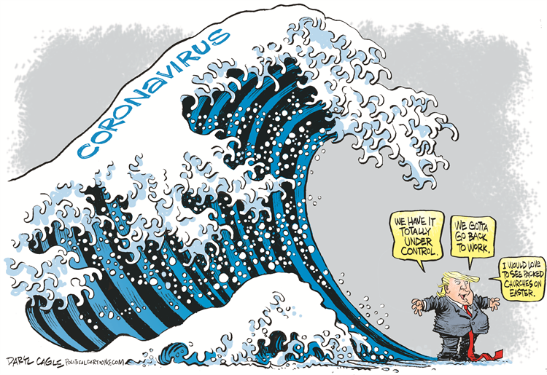

Slide 12
In which direction are the cartoons slanted, Conservative / Republican or Liberal / Democrat? Explain
How is President Trump’s role in the COVID 19 pandemic being represented by the artists? Explain with specific examples.
Do you believe the representations are justified? You must explain your opinion with elaborate details.
As Chief Executive of the US Government, and the implementation of inherent powers, the President may exercise action in the event of a crisis. How do you think executive actions have succeeded and failed as they pertain to the COVID 19 crisis?

