Slide 1


Origins of Government

Slide 2
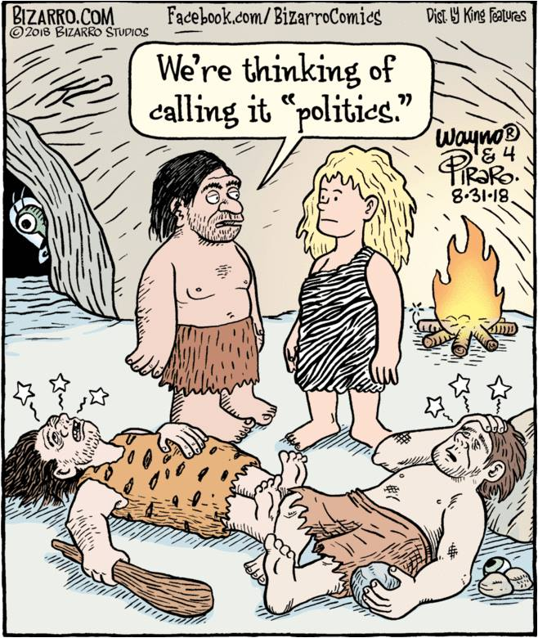

Slide 3


Viewpoints of Human Nature
Man is basically good
Man is basically selfish

Slide 4
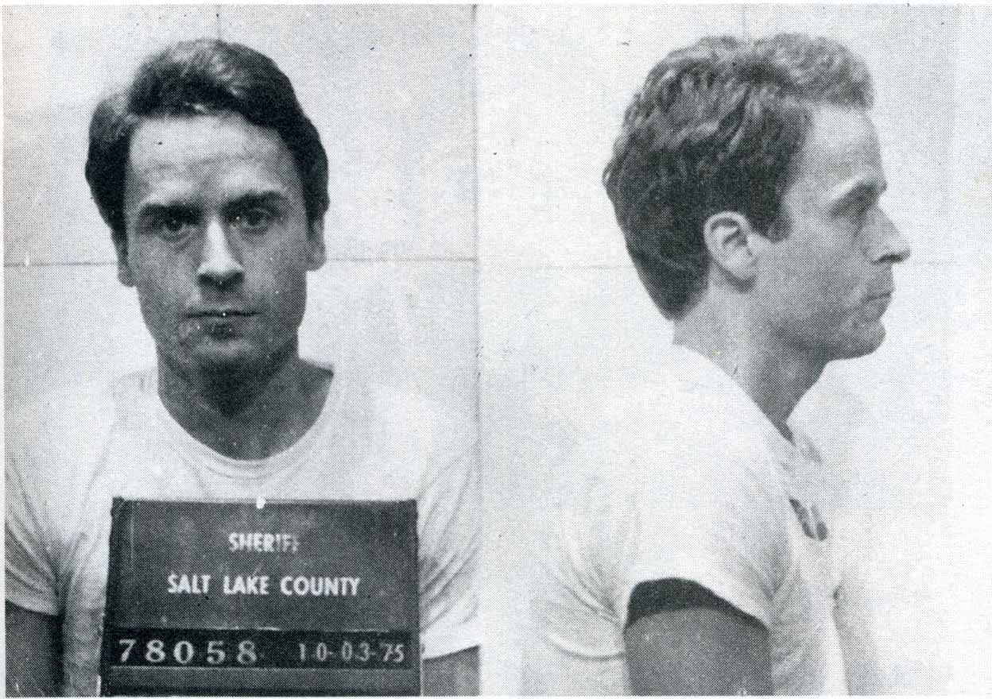
Ted Bundy

Slide 5

Law
Purpose: provide order / predictability
Rule of conduct prescribed by or accepted by a governing authority

Slide 6
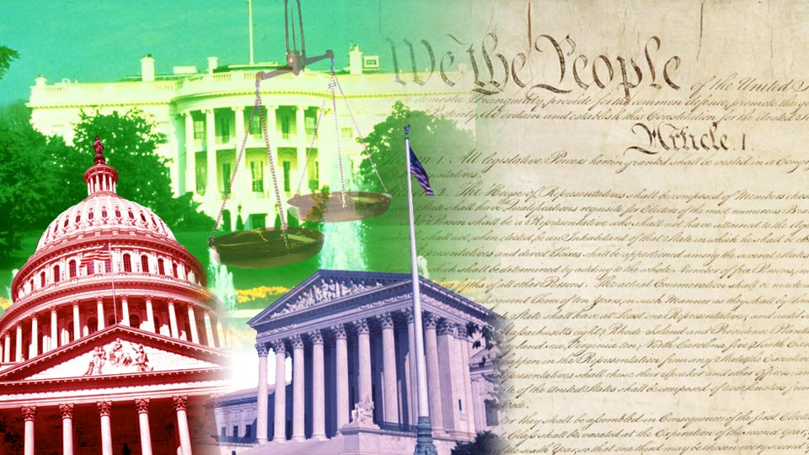

Government Powers
legislative power–makes law
executive power–enforces law
judicial power–interprets law

Slide 7
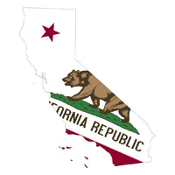

State vs. Nation
Features of a State
  political community
  occupies definite territory
  organized government

Slide 8
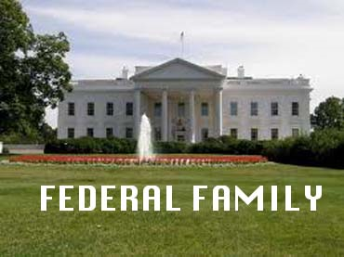
Theories of Origin
Evolutionary Theory
  state evolved from family

Slide 9
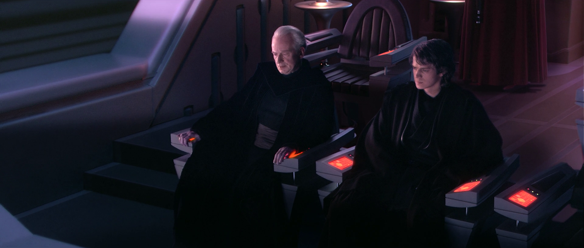
Force Theory
  state was born of force
  survival of the fittest

Slide 10

Divine Right Theory
  descendents of God
  chosen by God
  absolute Monarchy

Slide 11

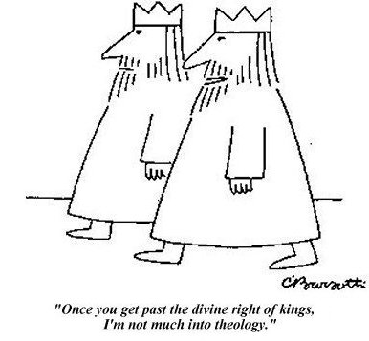

Slide 12
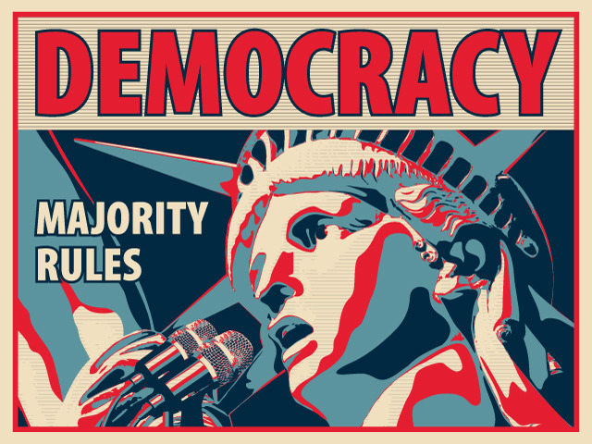
What is Democracy???
society controls the government – people rule

Slide 13
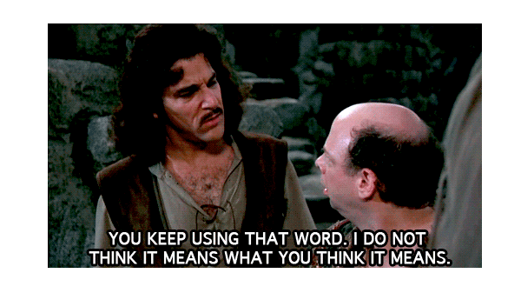
Republicanism

Slide 14
Republicanism
a republic is a form of government in which the people or some portion thereof retain supreme control over the government

Slide 15
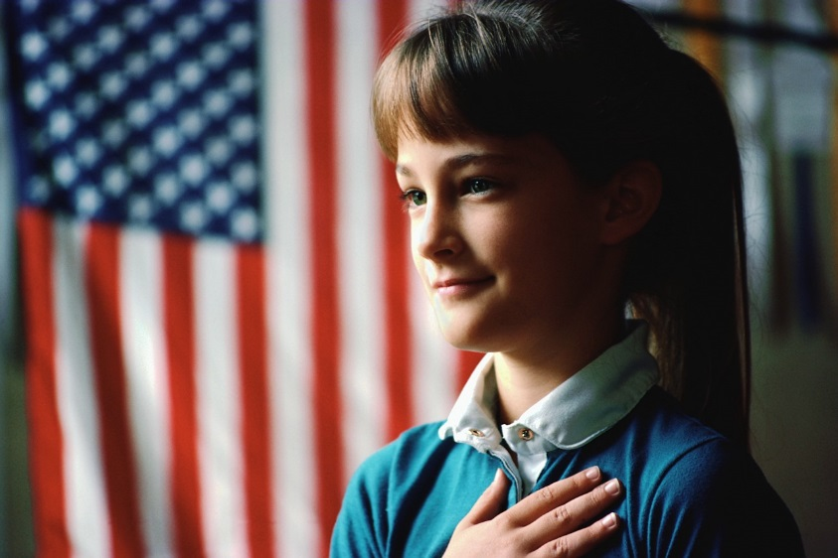
head of government is not a monarch
stresses a morality of social cohesion and devotion to the common welfare

