Slide 1
Origins of Religions

Slide 2
“Man makes religion: religion does not make man....The religious world is but the reflex of the real world....Religion is the sigh of the oppressed creature, the sentiment of a heartless world, and the soul of soulless conditions. It is the opium of the people....”
~Karl Marx

Slide 3
https://www.youtube.com/watch?v=gDCiqWcV7NY
Mahalia Jackson – Old Time Religion

Slide 4
re - li - gion
Probably derived from the Latin, meaning “to tie back,” “to tie again”
All religion shares the goal of tying people back to something behind the surface
There is a greater reality which lies beyond this world

Slide 5
Attempts to connect to a greater reality have taken many forms
Religious institutions are complex
They are not fixed and distinct categories
In many cultures & times, religion has been a basic foundation of life

Slide 6
Modes of Considering Unseen Reality
2 ways of apprehending reality:
rational thought
unrational modes of knowing

Slide 7
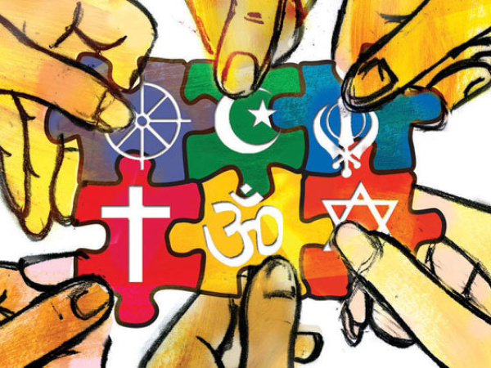
Some people come to religious convictions indirectly
through teacher or the teachings of religious traditions
Other people develop faith only through questioning

Slide 8
Our normal waking consciousness, rational consciousness as we call it, is but one special type of consciousness, whilst all about it, parted from it by the filmiest of screens, there lie potential forms of consciousness entirely different.
~William James

Slide 9
Mysticism
pursuit of communion with, identity with, or conscious awareness of an ultimate reality, divinity, spiritual truth, or God through direct experience, intuition, instinct or insight.

Slide 10
usually centers on practices intended to nurture those experiences
may be dualistic, maintaining a distinction between the self and the divine

Slide 11
According to Joachim Wach (1898-1955), every religion seems to follow a certain pattern
it is an experience of what is considered Unseen Reality
it involves the person’s whole being
it is the most shattering and intense of all human experiences
it motivates the person to action

Slide 12
Comparative Religions
Discipline that attempts to compare and understand religious patterns found around the world

Slide 13
Mircea Eliade
Sacred
the realm of the extraordinary, apparently purposeful, but generally imperceptible forces

Slide 14
Profane
the everyday world of seemingly random, ordinary and unimportant occurrences

Slide 15
Views of Reality
Immanent
to experience reality is present in the world
Transcendent
to believe that reality exists outside the material universe

Slide 16
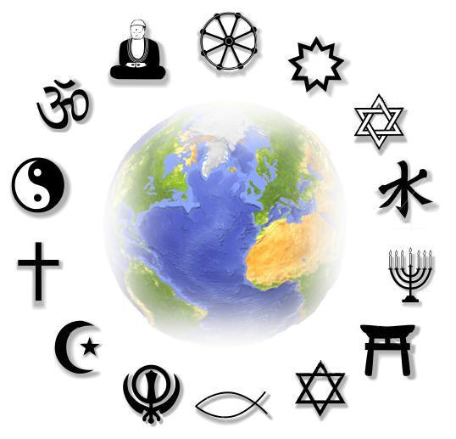
Incarnations
some people believe that sacred reality is usually invisible but can appear in human form
Christ
Krishna

Slide 17
Atheism
belief there is no deity
Agnosticism
not a denial of the divine, but uncertainty of its existence

Slide 18
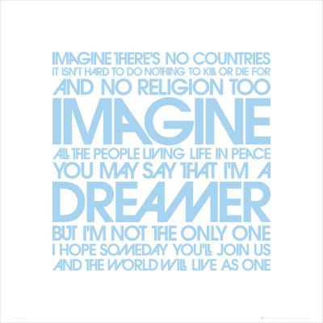
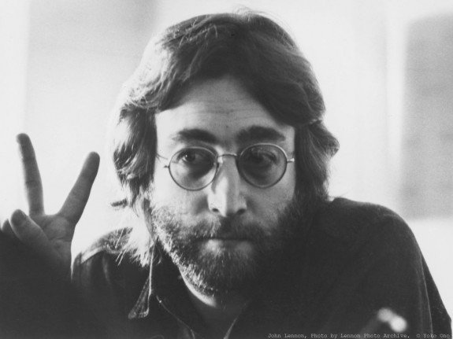

Slide 19
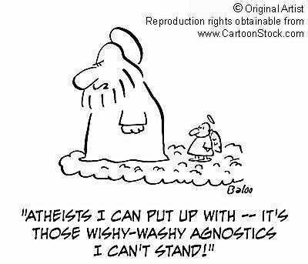

Slide 20
Worship
Attempts to express reverence
Enter into communion with object of worship
Acts of worship that are predictable and repeated are rituals

Slide 21
Symbols
Images borrowed from material world that are similar to ineffable spiritual experiences
Carl Jung proposed that humanity as a whole has a collective unconscious of archetypal symbols from which separate cultures have drawn

