Slide 1
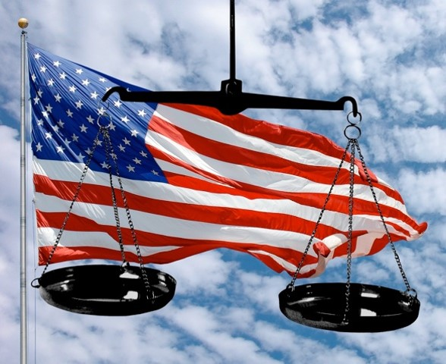

National & States' Powers

Slide 2
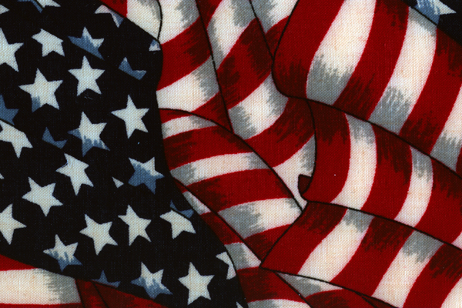
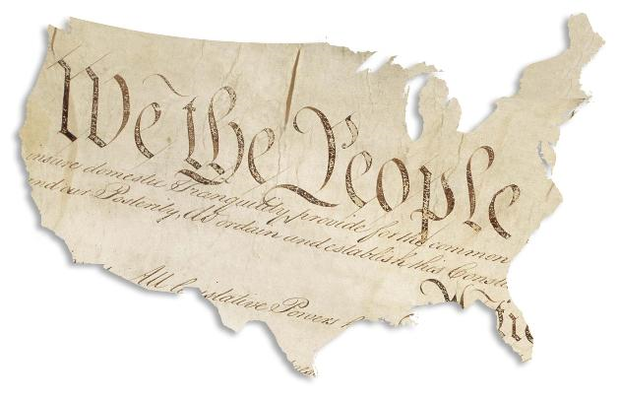
Federalism
constitutional agreement in which power is divided between a central government and state & local governments

Slide 3


National Powers
expressed powers
  powers directly expressed or stated in the Constitution
    coining money
    war
    regulating commerce

Slide 4
taxing
  Power denied to the government by the Articles of Confederation
  may have been most important decision by the delegates at the Constitutional Convention

Slide 5
implied powers
  powers that the government requires to carry out the expressed constitutional powers
    draft

Slide 6

inherent powers
  power of a government to enact legislation protecting health, safety, welfare, and morals of those within its jurisdiction
    immigration

Slide 7
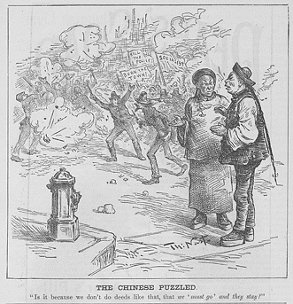
‘The Chinese Puzzled’ by Thomas Nast, 1886: Nast lampoons the Knights of Labor, a mainly Catholic organization which supported the Chinese Exclusion Act and whose rallies often ended in violence. He’s suggesting it is crazy that troublemakers and anarchists were more welcome in America than peaceful Chinese immigrants.

Slide 8
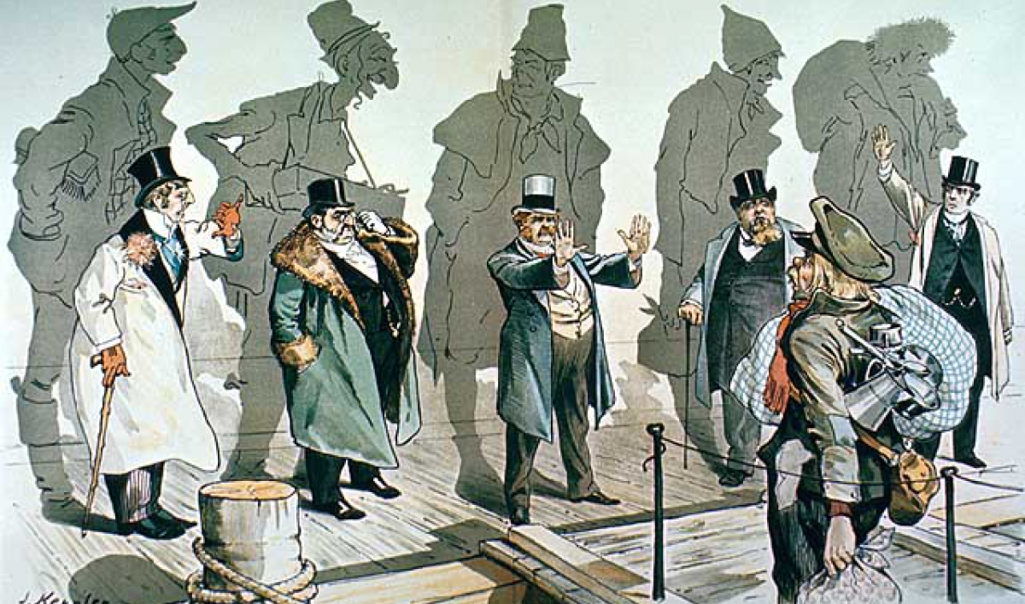
‘Looking Backward’ by Joseph Keppler, 1893: The shadows on the wall reveal what the five wealthy men were when they first arrived to America. This is a warning against placing restrictions on immigration.

Slide 9
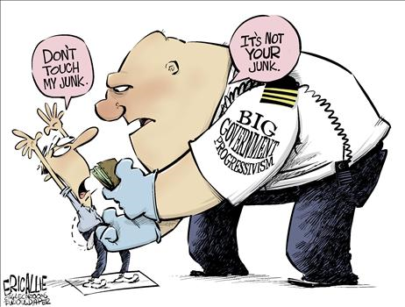

Slide 10
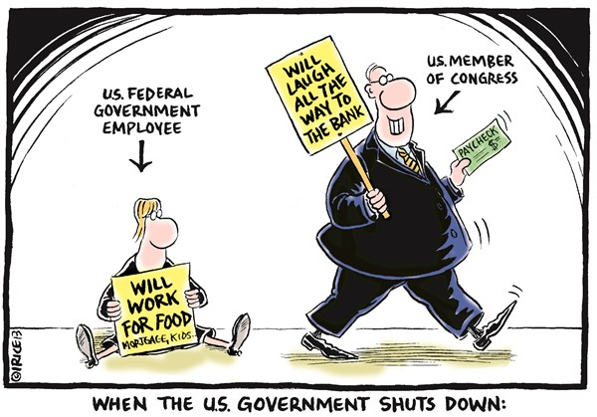

Slide 11
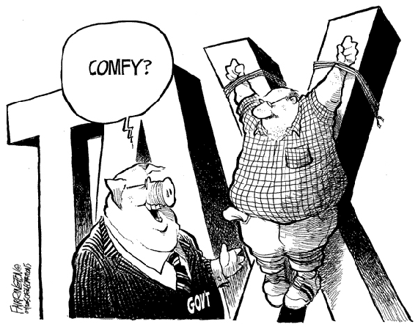

Slide 12
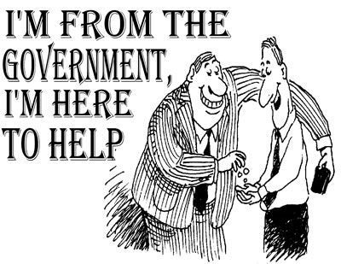

Slide 13


Slide 14
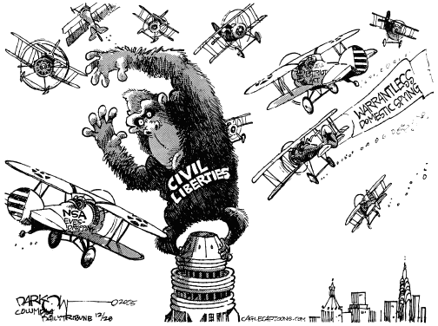

Slide 15
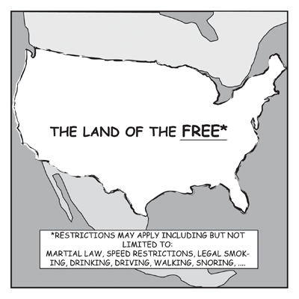

Slide 16
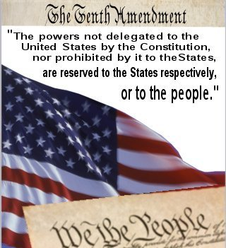

Slide 17

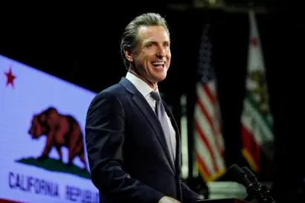

States & the Nation
reserved powers
  state-specific
    schools
    licenses for professionals
    local government

Slide 18
supremacy clause
  state law cannot conflict with federal law
  laws and treaties made by the federal government are the “supreme law of the land”

Slide 19
concurrent powers
  powers that both the national government and states have
    taxes
    courts
    defining crimes

Slide 20
denied powers
  Constitution denies some powers to both levels
    taxing exports

Slide 21
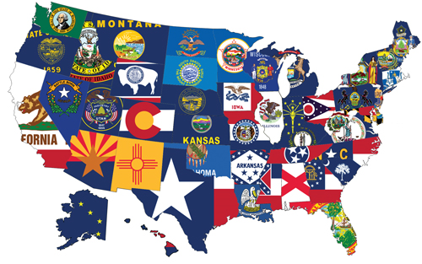
Guarantees to the State
republican government
protection
territorial integrity

Slide 22
Article IV
full faith and credit
  states must recognize laws of other states
  applies to civil law only

Slide 23
Privileges and immunities
  citizens of each state enjoy the rights in the other states, such as
    live in any state
    use the courts
    make contracts
    buy, sell and hold property
    marry

