Slide 1
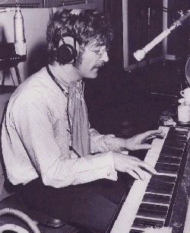
John Lennon

Slide 2
By the 1960s after playing in
Germany to refine their skills…
He formed several bands, the 1st in 1956 called The Quarrymen
He soon invited Paul McCartney to join, after their 1957 meeting at St. Peter’s Church in 1955
The name was changed to The Beatles

Slide 3
He had married a fellow art student , in 1962, before the Beatles were famous and had a son Julian
In 1967 He went to an art exhibition in London by Yoko Ono and fell in love
He divorced Cynthia, and married Yoko in 1969

Slide 4
In 1966, Lennon was quoted in an interview with Maureen Claeve as saying:
Christianity will go. It will vanish and shrink. I needn't argue about that; I'm right and I'll be proved right. We're more popular than Jesus now; I don't know which will go first – rock and roll or Christianity. Jesus was all right but his disciples were thick and ordinary. It's them twisting it that ruins it for me

Slide 5
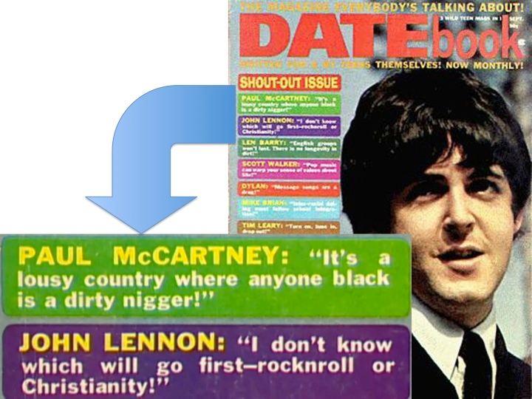

Slide 6
Lennon compared the Beatles to Christianity, argued for its decrease in popularity and eventual disappearance, and even separated the historical figure Jesus from the religion bearing his name
This is the process of secularization
He expressed a religious philosophy that calls for “finding your own God and your own church”

Slide 7
In his posthumously published book Skywriting by Word of Mouth, John Wrote: I always remember to thank Jesus for the end of my touring days; if I hadn’t said that the Beatles were ‘bigger than Jesus’ and upset the very Christian Ku Klux Klan, well, Lord, I might still be up there with all the other performing fleas! God bless America. Thank you, Jesus. (Pages 17-18)

Slide 8
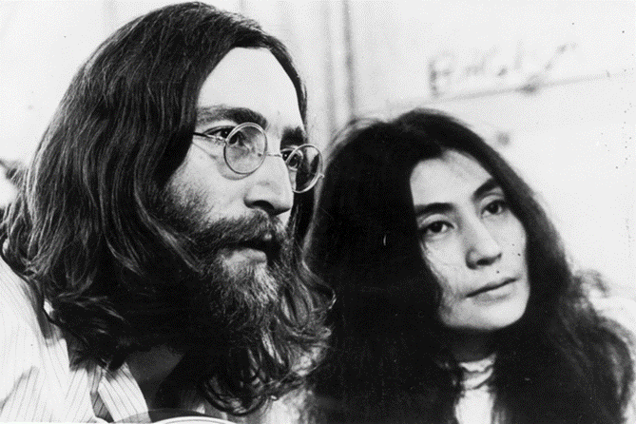
John & Yoko became involved in the Peace Movement
During the late sixties the Hippy Movement evolved, many young people became interested in alternative life styles

Slide 9
The Beatles were part of this, they grew their hair, went on trips to India to study transcendental meditation with the Maharishi, and talked about world issues

Slide 10
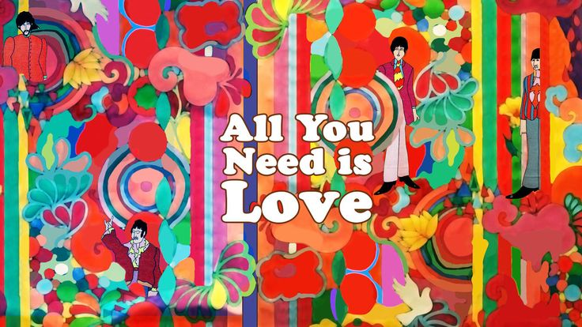
Lennon, along with the other Beatles, sought above all to advance the message of love as a humanitarian value

Slide 11
The Beatles broke up…
They last played live in 1969, on top of a building in London
They had all begun to want to do different things
John and Yoko began to record their own records, they were very unusual

Slide 12
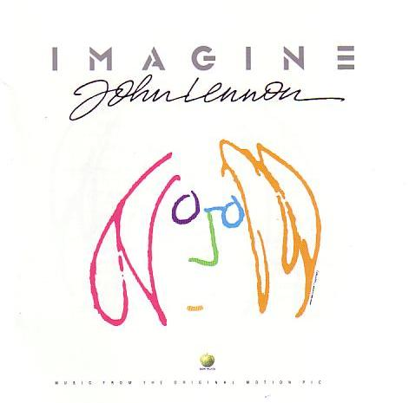
Lennon now lived in USA
recorded his most famous song in 1971 Imagine
It was voted Song of the Millennium nearly 30 years later
Rolling Stone ranked it number 3 on their list of “500 Greatest Songs of All-Time”

Slide 13
Imagine is Lennon’s most forceful “ideological” song, usually regarded as a call for the establishment of a human utopia
The lyrics are similar to the Communist Manifesto
The final verse transposes early Christian idealism to a modern search for a “brotherhood of man”

Slide 14
Lennon’s music contains two interrelated religious phenomena
Religious Sensibilities – Lennon’s acceptance of certain aspects of Jesus’ teachings, and their central place in his personal development and art
Unbelief and Alternative Ideas – Lennon’s resistance to conventional Christian ideas, institutions, and modes of thinking and acting, as well as his attempt to replace them with alternative ideas and concepts

Slide 15
One important feature of secularization may have significance for Lennon’s decision to use his art as a means of promoting his gospel of existential love and world peace
Secularization leads to the diminution of religion’s social significance
Religion therefore becomes less relevant to the status and operation of social roles as well as to the beliefs and actions of the individual

Slide 16
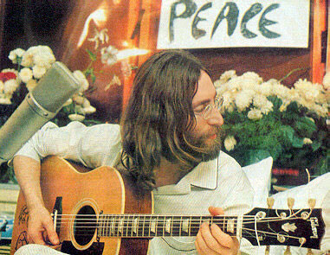
Humanistic quasi-religion illuminates the ideological construction of Imagine , as well as Lennon's general conception of religion
It is a plea for moral self-responsibility and a quest for an ideal society in the here and now

Slide 17
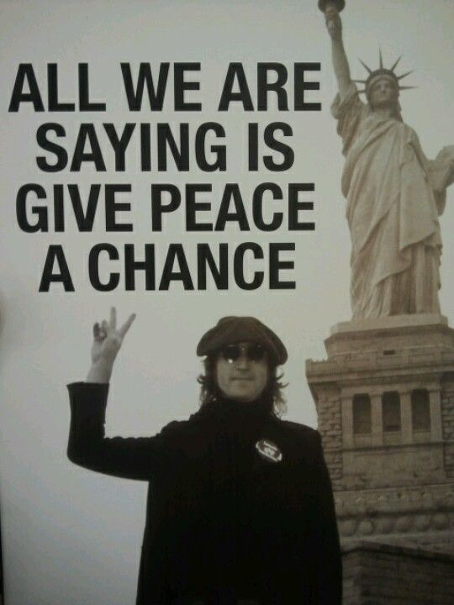
Lennon’s religiosity is a call for practical idealism, for a freedom of the mind from beliefs and practices that withhold existential love and prevent world peace

Slide 18
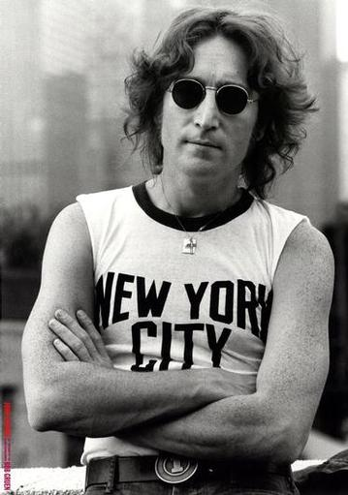
By 1980…
had begun to record again
wrote of his happiness and love for Yoko
On December 8th 1980 a crazed fan shot John dead outside his flat in New York

Slide 19
Legacy of John Lennon
wonderful musical partnership with Paul McCartney in The Beatles which was the sound track of The Sixties

Slide 20
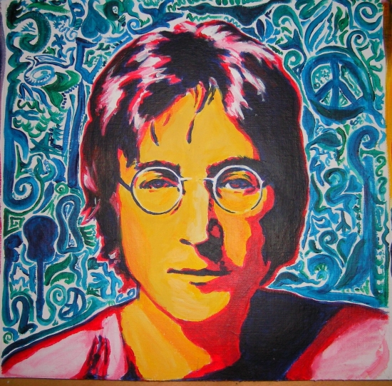
A wide body of music using different styles and instruments
He brought a high profile to the peace / anti-war movement involving young people in politics

