Slide 1
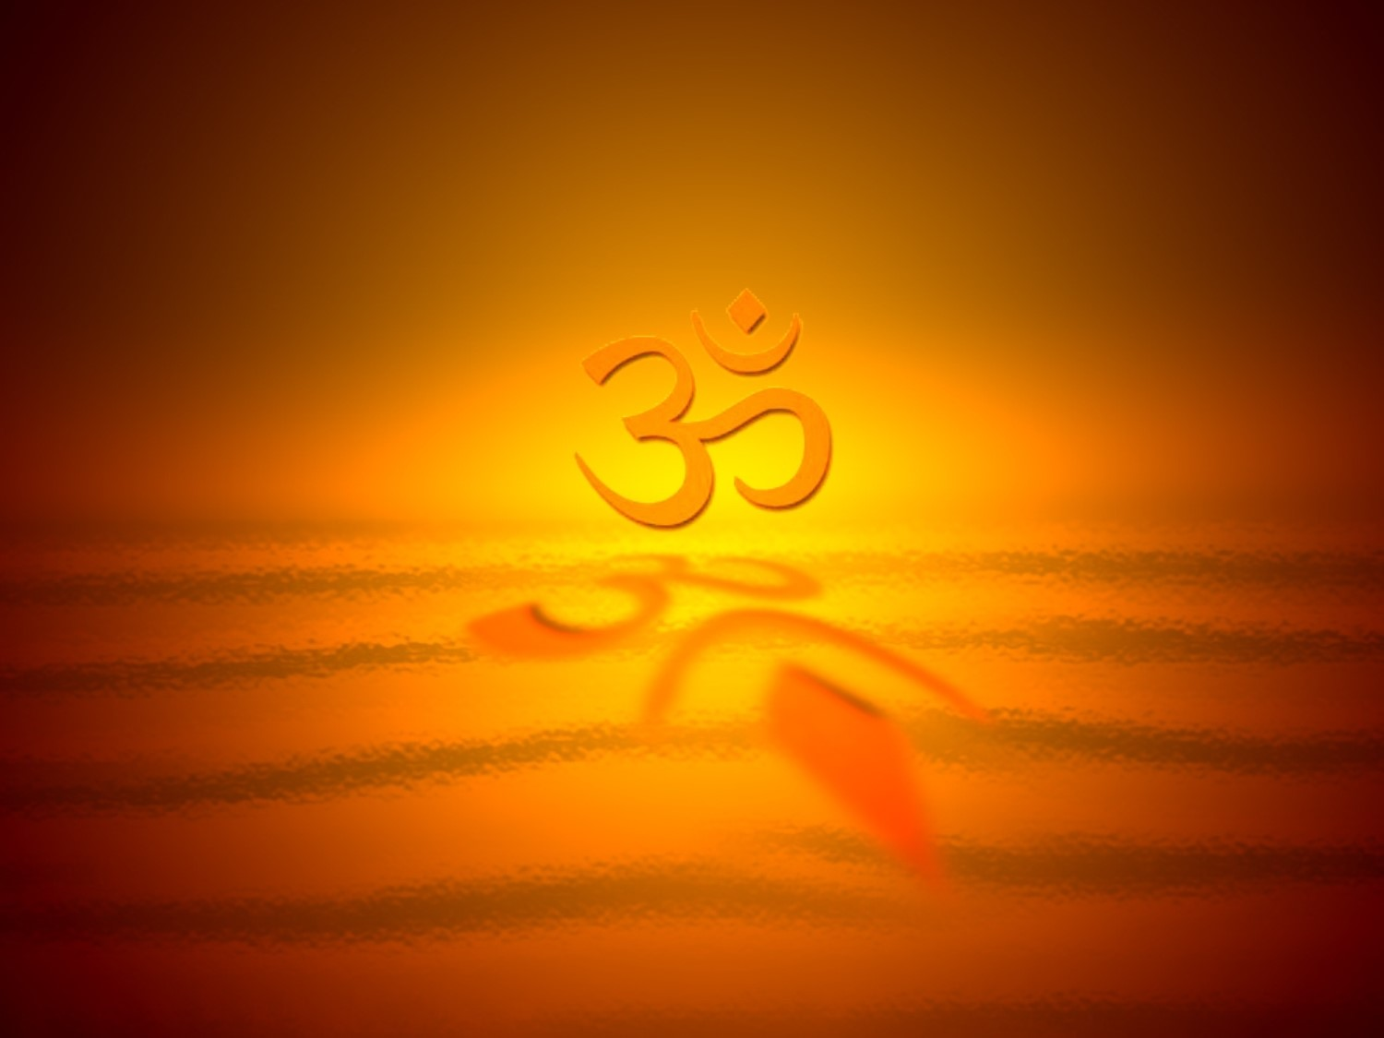
Hinduism

Slide 2
Hinduism has
  no founder
  no central authority
  no church
  no one main book
  no fixed creed
  It is tolerant of many other beliefs
Why would this make it difficult for other religions to take hold in India?

Slide 3
“In the beginning there was Existence alone--One only, without a second. He, the One, thought to himself: Let me be many, let me grow forth. Thus out of himself he projected the universe, and having projected out of himself the universe, he entered every being. All that is has its self in him alone. Of all things he is the subtle essence. He is the truth. He is the self. And that....THAT ART THOU.”
~Chandogya Upanishad

Slide 4
“There is no truth superior to Me. Everything rests upon Me, as pearls are strung on a thread....
I am the taste of water, the light of the sun and the moon, the syllable om in Vedic mantras; I am the sound in ether and ability in man....All states of being--goodness, passion, or ignorance--are manifested by My energy. I am, in one sense, everything--but I am independent. I am not under the modes of this material nature.”
~Bhagavad Gita

Slide 5
Timeline
c. 8000-6000 BCE
c. 2500-1500
c. 2000-900
c. 1500
c. 1000-500 BCE
c. 400 BCE-200 CE
c. 400 BCE-400 CE
200 BCE
100-300 CE
c. 600-1800
711
c. 788-820
1556-1707
1836-1886
1857-1947
Traditionally, Vedas heard by rishis
Indus Valley civilization
Supposed Aryan invasions of N. India
Early Vedas composed
Upanishads systematized by Vyasa
Ramayana (present form)
Mahabharata (present form)
Traditionally, Patanjali edits Yoga Sutras
Code of Manu compiled
Bhakti movement flourishes
Muslim invasions begin
Shankara reorganizes Vedanta
Mogul Empire
Life of Ramakrishna
British rule of India

Slide 6
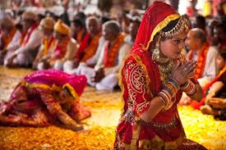
Introduction
Some scholars claim there is no central tradition that can be identified as Hinduism
The term Hinduism did not become common until the 19th century

Slide 7
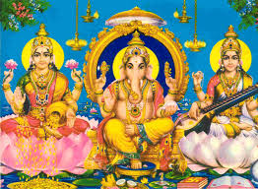
A range of practices that vary according to region, caste, gender, and education
The philosophic Brahmanic tradition often referred to as Hinduism is but one aspect of a larger tradition

Slide 8
Simple Background
“Hinduism” is a 19th-century word
  Persian: hindu
  Sanskrit sindhu (“river”)
  Religions from the Indus Valley
  “Indian Religion(s)”
750+ million “Hindus” in India
30+ million “Hindus” abroad
Third largest religion in the world
Notes:
8

Slide 9
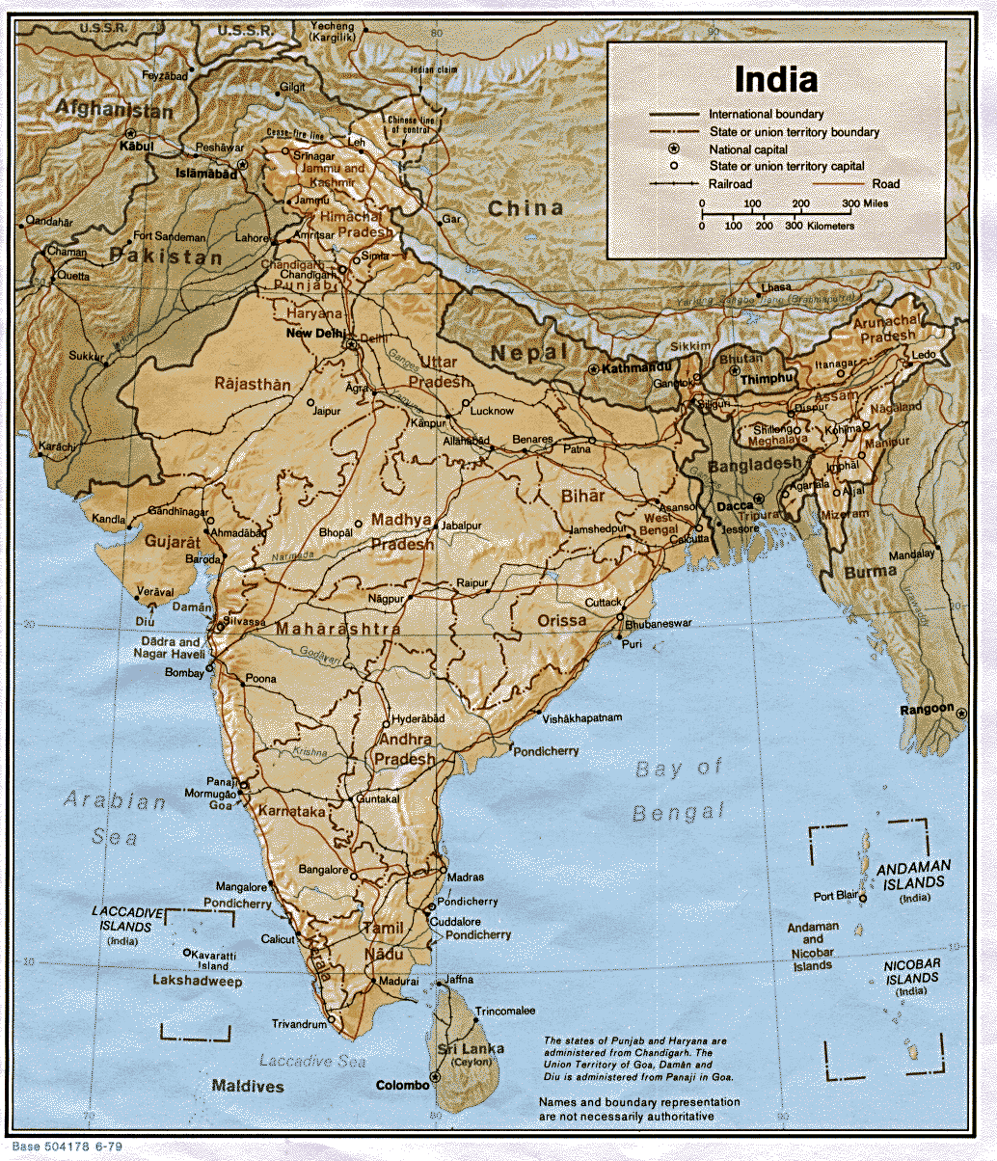
The vast majority of Hindus live in India and Nepal

Slide 10
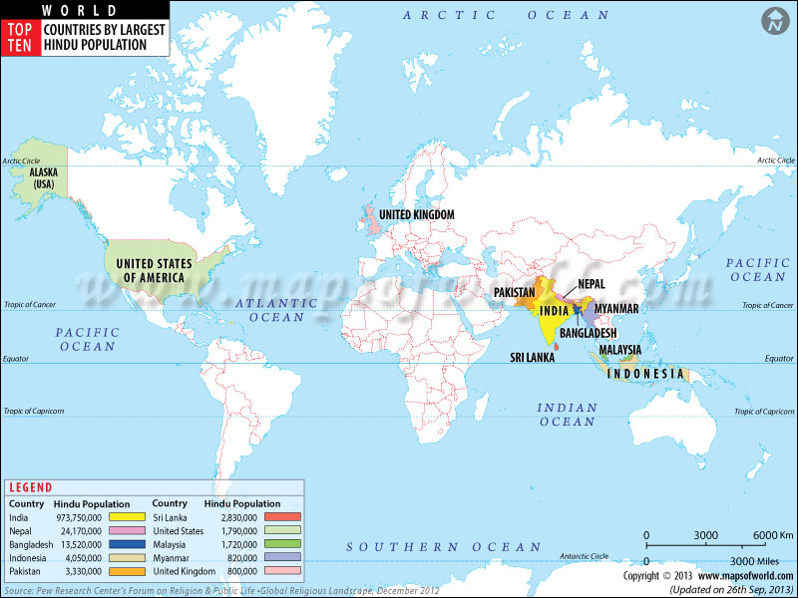

Slide 11
Hinduism is one of the oldest religious traditions in the world
  From at least 2500 BC there were people living in the Indus Valley
  Several cities with advanced plumbing, architecture, and populations of 40,000+ (e.g., Harappa and Mohenjo-daro) flourished

Slide 12
Definition of Hinduism
Indian Supreme Court 1966
Acceptance and reverence for the Vedas
A spirit of tolerance
Belief in vast cosmic periods of creation and destruction

Slide 13
Belief in reincarnation
Recognition of multiple paths to salvation and truth
Polytheism
Philosophical flexibility (no single dogma)

Slide 14
Philosophical & Metaphysical Origins
Brahmanic tradition traces back to the Vedic age, thousands of years ago
The Indus Valley Civilization
  history and precise dating of this period is controversial

Slide 15

The Vedas
  Foundation of upper-caste Brahmanic Hinduism
  Revered collection of ancient sacred hymns
  The Rig Veda is the first & oldest of 4 collections

Slide 16
The earliest forms of Hinduism are often called “Vedic” (2500-800 BCE)
Dominated by a priestly class concerned with “fire sacrifices”
The fire rituals communicated with the gods, influenced them, and restored the vital powers of the universe
Dyaus Pitr (cf: Zeus & Jupiter)
Agni (god of fire)
Soma (a god & a drug?)

Slide 17
“If I were asked under what sky the human mind . . . has most deeply pondered over the greatest problems of life, and has found solutions to some of them which well deserve the attention even of those who have studied Plato and Kant--I should point to India. And if I were to ask myself from what literature we who have been nurtured almost exclusively on the thoughts of Greeks and Romans, and of one Semitic race, the Jewish, may draw the corrective which is most wanted in order to make our inner life more perfect, more comprehensive, more universal, in fact more truly human a life . . . again I would point to India.” ~Max Müller.
Notes:
17

Slide 18
“"I should have been glad to acquire some sort of idea of Hindu theology, but the difficulties were too great.”
~Mark Twain
Notes:
18

Slide 19
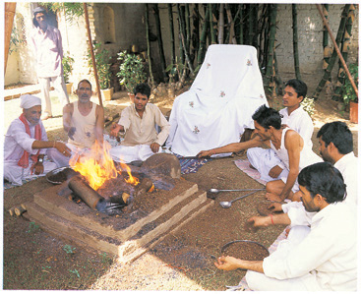
Vedic fire sacrifices have been made for over 3000 years

Slide 20
What do people want?
Notes:
20

Slide 21
What do people want?
Pleasure
Notes:
21

Slide 22
What do people want?*
*based on Huston Smith’s, World Religions
Pleasure
Success: wealth, fame, power
  competitive (& precarious)
  insatiable (potentially)
  centers on the self (lower-case “s”)
  achievements are ephemeral
Notes:
22

Slide 23
What do people want?
Pleasure
Success: wealth, fame, power
Together, we can think of these two as the “path of desire.”
Notes:
23

Slide 24
What do people want?
Pleasure
Success: wealth, fame, power
Duty
What do people really want/desire?
Notes:
24

Slide 25
What do people want?
Pleasure
Success: wealth, fame, power
Duty
What do people really want/desire?
“being”
“knowing”
joy
Notes:
25

Slide 26
What do people want?
Pleasure
Success: wealth, fame, power
Duty
What do people really want/desire?
“being”infinite being
“knowing”infinite awareness
joyinfinite bliss
Notes:
26

Slide 27
What do people want?
Pleasure
Success: wealth, fame, power
Duty
Liberation (moksha)
  “Liberation from the cycle of existence (samsara) often identified with a state of knowledge in which the phenomenal world and its concerns are shut out in favor of a mystical identification with the ultimate, changeless ground of all things.”--Oxford Dictionary of Philosophy
  “release from the finitude that restricts us from the limitless being, consciousness, and bliss our hearts desire”--Huston Smith
Notes:
27

Slide 28
Life’s Limitations
pain (physical & psychological)
ignorance
restricted being
Notes:
28

Slide 29
Four Paths
reflective | through knowledge Jnana (yoga)
emotional | through love bhakti (yoga)
active | through work karma (yoga)
experimental | through experiment raja (yoga) [hatha]
Notes:
29

Slide 30
Common Preliminary Commitments
Cultivate habits of:
  non-injury
  truthfulness
  non-stealing
  self-control
  cleanliness
  contentment
  self-discipline
  compelling desire
Notes:
30

