Slide 1
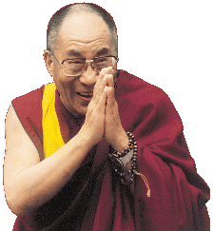
Intro to Buddhism

Slide 2
“When you open your mind to the truth, then you realize there is nothing to fear. What arises passes away, what is born dies, and is not self--so that our sense of being caught in an identity with this human body fades out. We don’t see ourselves as some isolated, alienated entity lost in a mysterious and frightening universe. We don’t feel overwhelmed by it, trying to find a little piece of it that we can grasp and feel safe with, because we feel at peace with it. Then we have merged with the Truth. —Ajahn Sumedho, Buddhist monk

Slide 3
“Be the master of your own mind.” —The Buddha

Slide 4
All things come at first from MIND
Mind creates them, mind fulfills them
Speak or act with tainted mind,
You’ll drag around a cart of pain
All things come at first from MIND
Mind creates them, mind fulfills them
Speak or act with lucid mind
And joy will follow like your shadow.
~The Dhammapada

Slide 5
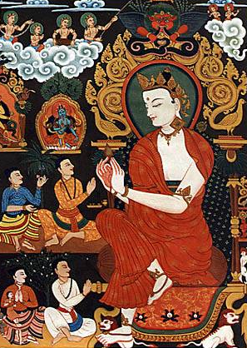
Siddhartha Gautama (563-483 BCE)
Born in NE India (Nepal)
Raised in great luxury to be a king
At 29 he rejected his luxurious life to seek enlightenment and the source of suffering

Slide 6
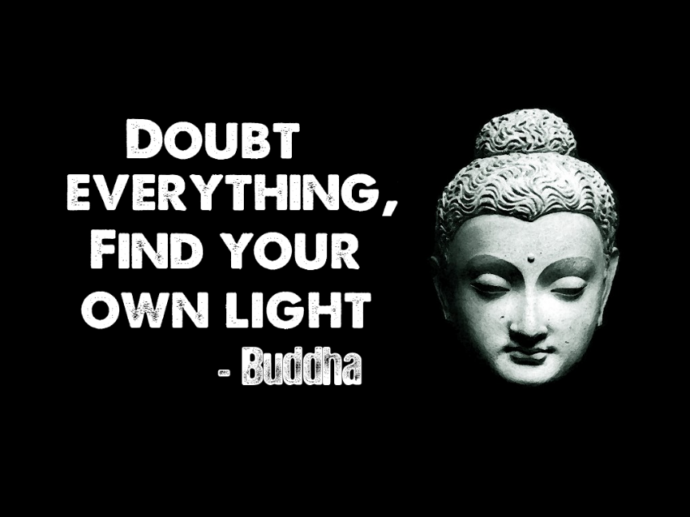
Lived a strict, ascetic life for 6 yrs
Rejecting this extreme, sat in meditation, and found nirvana
Became “The Enlightened One,” at 35

Slide 7
Life and Legend of the Buddha
Buddha is a generic term meaning “Enlightened One”
What we know about him has been passed down through his followers
Prolific teachings passed down orally; written down hundreds of years after his death

Slide 8
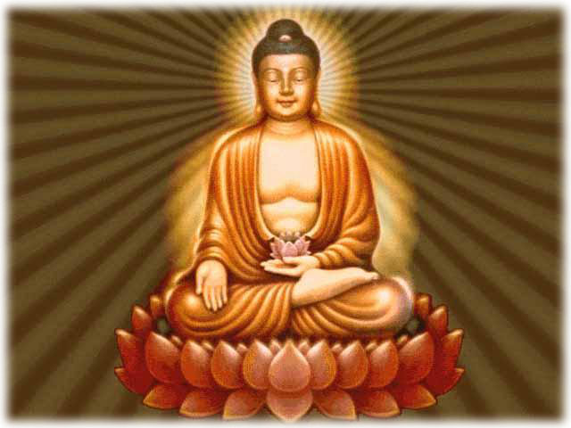
Followers have recalled his life in sacred biographies
led a sheltered life of luxury
Left home and saw the Four Sights: a bent aged man, a sick person, a corpse, and a monk

Slide 9
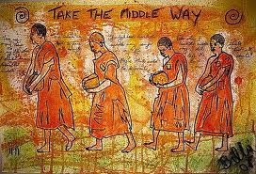
Found extreme lifestyles did not answer his questions
led to the Middle Way: neither self-indulgence nor self-denial
Vowed to sit under tree at Gaya until enlightenment

Slide 10
Experienced 4 states of contemplation and had 3 realizations, he could:
recall all his past lives
see the entire cycle of life and death
see the cause of suffering and the means of ending it

Slide 11
Siddhartha became the Buddha, the one who woke up
Spent the next 45 years teaching
His teaching (dharma) included Four Noble Truths, the Nobel Eightfold Path, the Three Marks of Existence

Slide 12
Some followers became monks (bhikshus); women were allowed to become nuns if they followed the 8 special rules
Disciples (the sangha) accepted people from all castes and levels of society

Slide 13
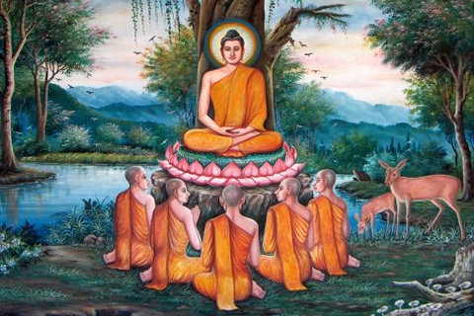
When the Buddha died, he told his followers to be responsible for their own spiritual development

Slide 14
The Essence of Buddhism
The “middle way of wisdom and compassion”
2,500 year old tradition
The 3 jewels of Buddhism:
Buddha, the teacher
Dharma, the teachings
Sangha, the community

Slide 15
What is the fundamental cause of all suffering?
Desire!
Therefore, extinguish the self, don’t obsess about oneself

