Slide 1
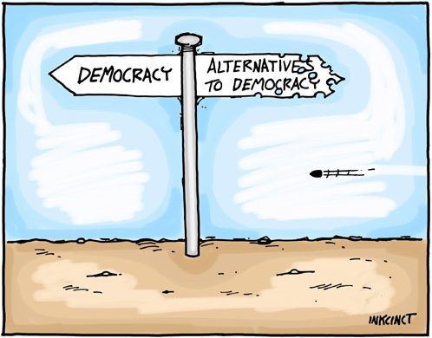

Influential Political Philosophers

Slide 2

Social Contract Theory
presumption of an imaginary, or actual, agreement to set up a government and obey its laws
ideas of justice and equity are closely connected with what men feel they have an obligation to do
  can involve unwritten rules of customary social behavior

Slide 3
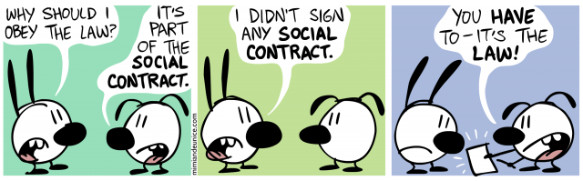

Slide 4
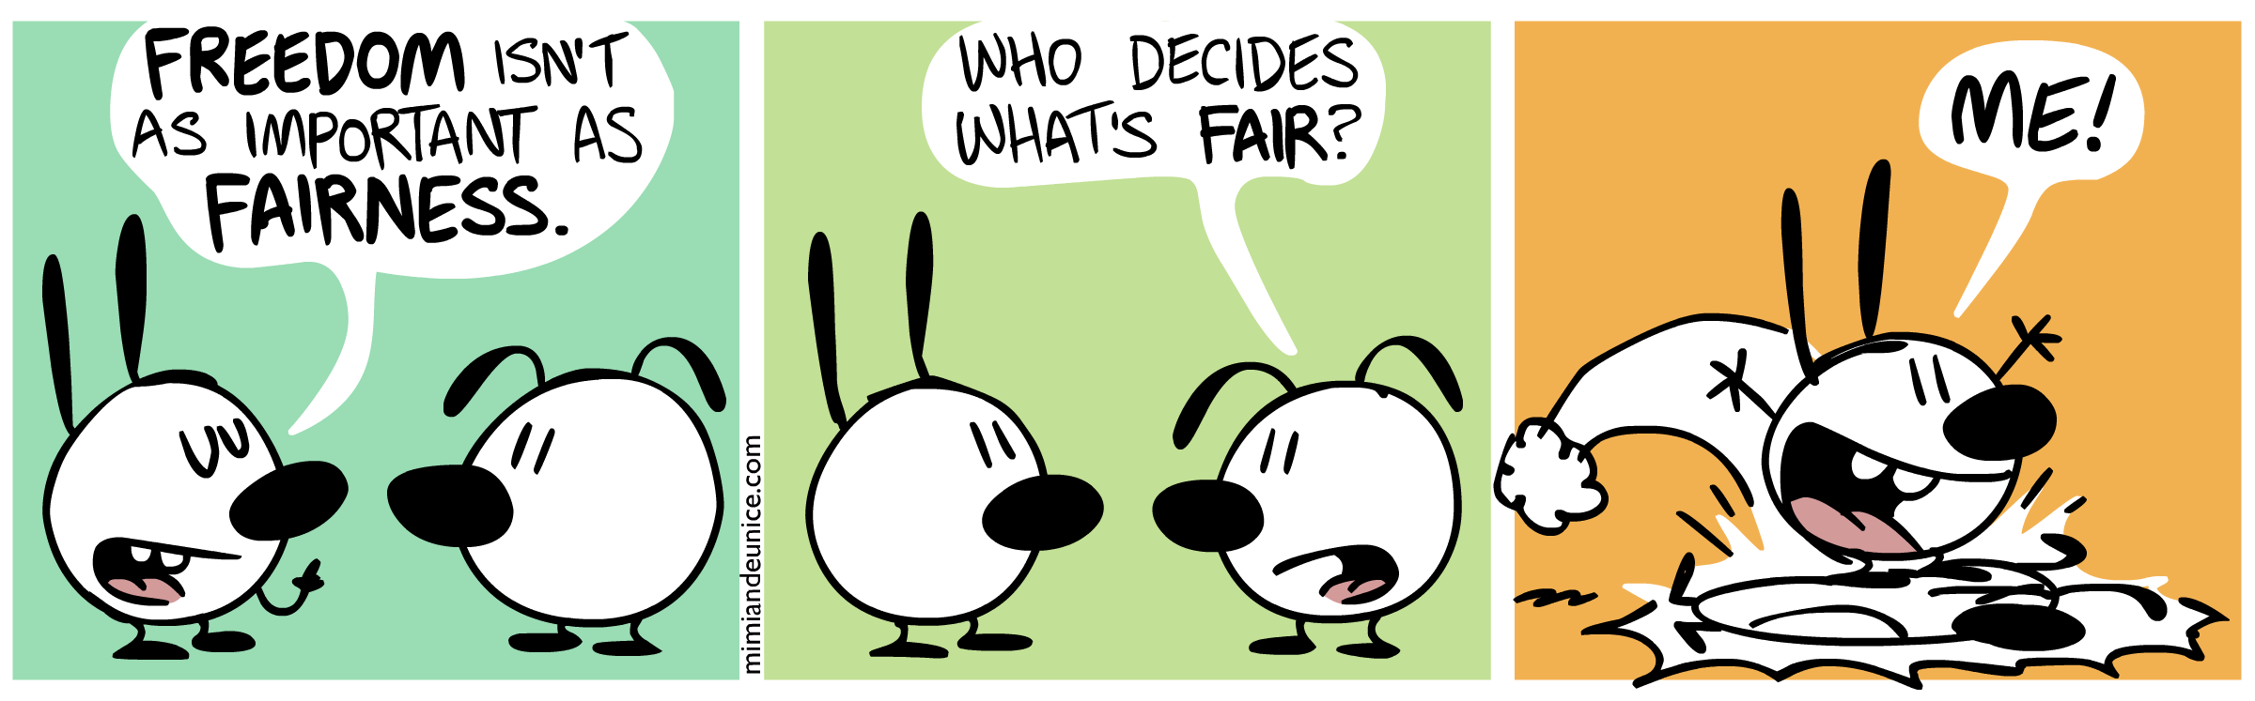

Slide 5

Natural Rights Philosophy
emphasizes the existence of inalienable rights of each person regardless of:
  wealth
  social status
  birth

Slide 6
Popular Sovereignty
  government is created and derives its authority from the agreement of the people

Slide 7
Common Law
body of rules prescribing social conduct and justiciable in the royal courts of England
body of principles embodied in or derived from precedents – the decisions of certain courts in England and other common law countries

Slide 8
Common law can be
  General customs – the universal rule of the whole kingdom, and form the common law, in its stricter and more usual signification
  Particular customs, which for the most part affect inhabitants within a specific area

Slide 9
Thomas Hobbes
a state of nature gives rise to a “war of every man against every man”
ensuing chaos would cause humans to leave a state of nature by entering into a social contract

Slide 10
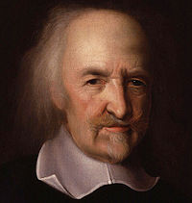
the social contract would give consent to be governed by an authoritarian state
order, stability and peace would be maintained

Slide 11
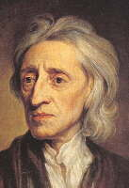
John Locke
English political thinker
Father of Classical Liberalism
wrote: Two Treatises of Government – 1690

Slide 12

humans live in a state of equality and freedom
humans have certain unalienable rights
    life, liberty and property

Slide 13
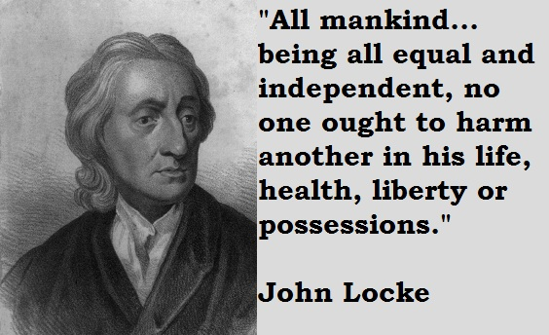
government should protect the rights of people
all rights begin in individual property interest created by an investment in labor

Slide 14
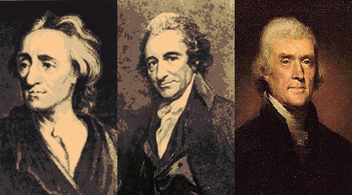
government depends on the governed
majority rule is the cornerstone of all political order

Slide 15
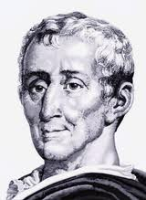
Baron de Montesquieu
member of the French nobility
wrote: The Spirit of Laws – 1748

Slide 16
there are 3 basic kinds of government:
    Republics (power lies in a body of citizens)
    Despotism (tyranny)
    Monarchy (A state ruled or headed by a monarch)

Slide 17
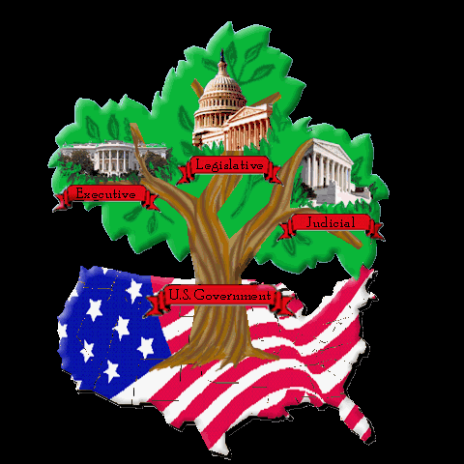
key concept – checks and balances
    executive, legislative, judicial branches
    each power controls the other

Slide 18
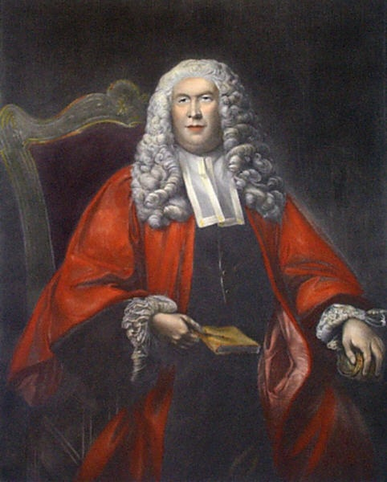
William Blackstone
English lawyer
wrote: Commentaries on the Laws of England
    Common Law – “Golden Rule”

Slide 19
Good custom is:
  ancient, noone can remember the beginning of it
  continuous, the rights claimed under it have never been abandoned or interrupted
  peaceable, supported by common consent of those using the custom
  compulsory, it is not left to the option of every man whether he will obey it or not
  consistent, one custom cannot contradict another without producing an absurdity

Slide 20

Common law protects:
  due process
  attorney-client confidentiality
  equality before the law
  habeas corpus
  right to confront accusers
  forbiddance of bills of attainder
  freedom from forced self-incrimination

Slide 21
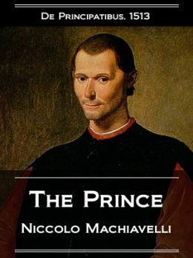
Niccolo Machiavelli
Italian Political thinker
wrote: The Prince
  the ruler should be feared
  must rule by force
  carefully choose advisers to assist

Slide 22
Influence on American Democracy
  separation of powers
  limit the power of the president
  protect citizens from tyranny

