Slide 1


Influential Documents
for
American Democracy

Slide 2
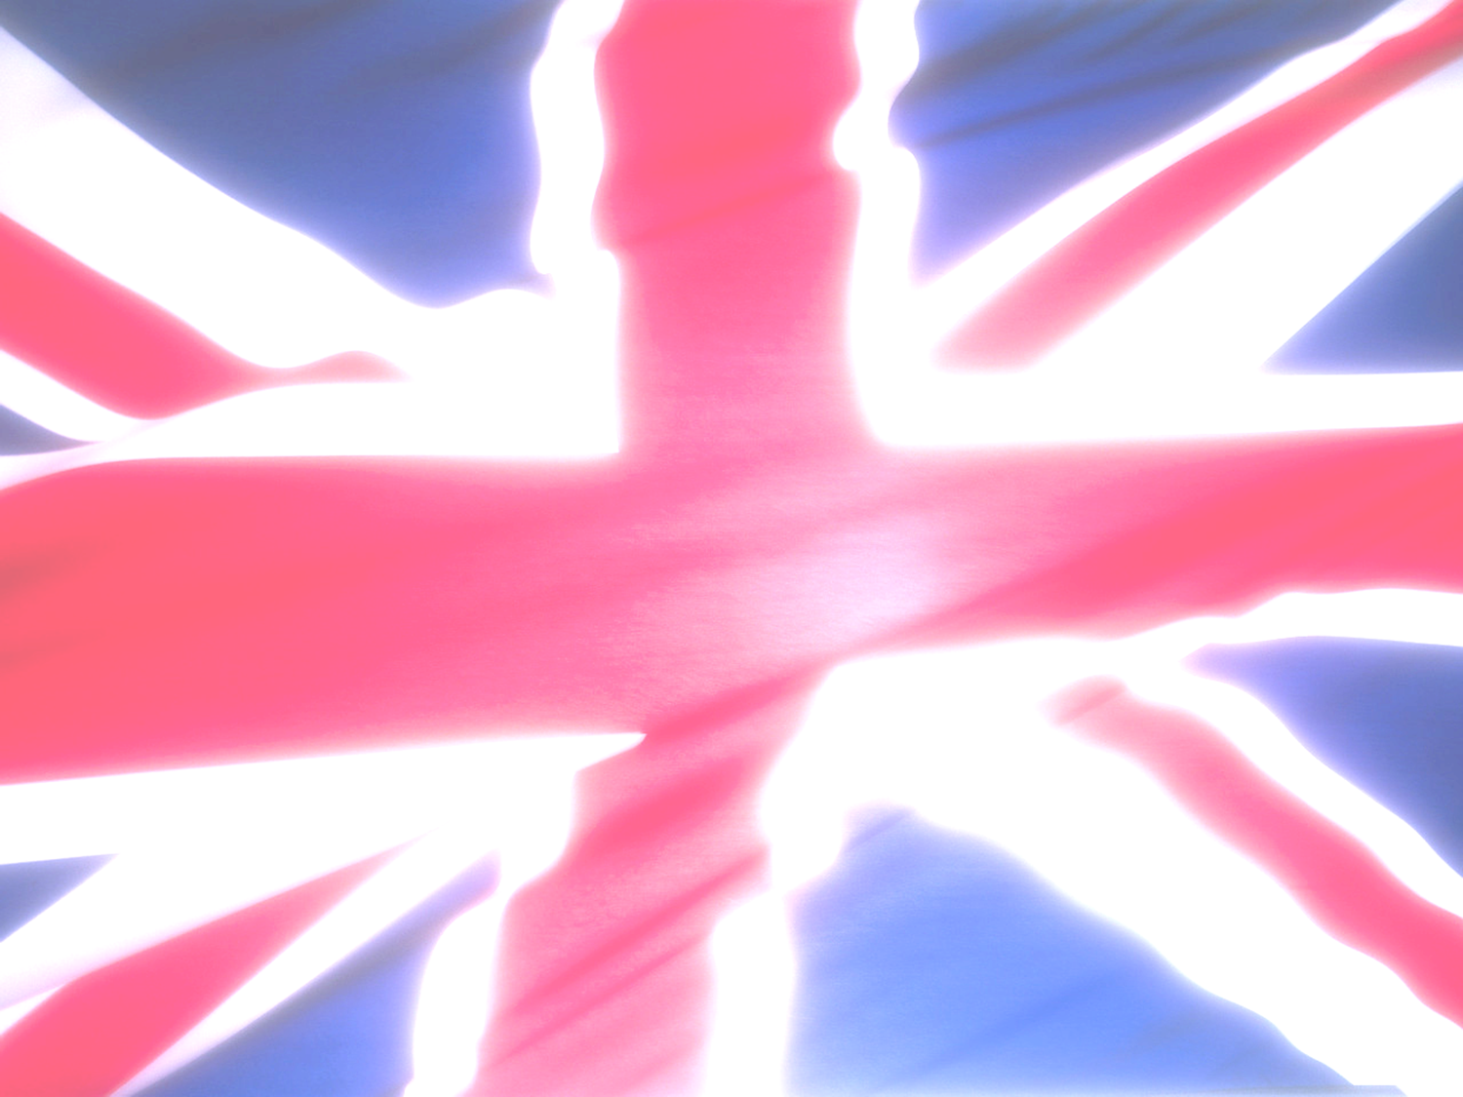
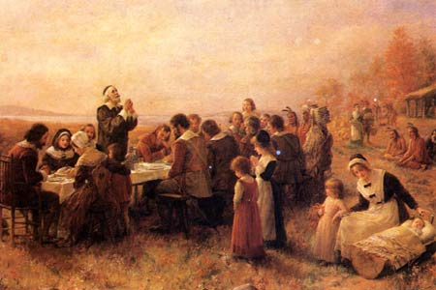
Early America –
on the road to self-government…
Looking at our Founding Fathers English Heritage through documents

Slide 3
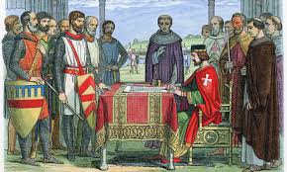
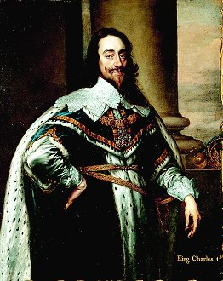
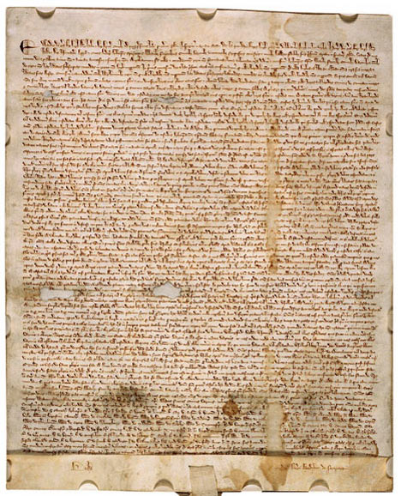
Democracy was not created in a heartbeat. In a world where people were ruled by monarchs from above, the idea of self-government is entirely alien

Slide 4

Limited Government
government should be the servant, not the master, of the people
a fundamental higher law, or constitution, should limit government

Slide 5
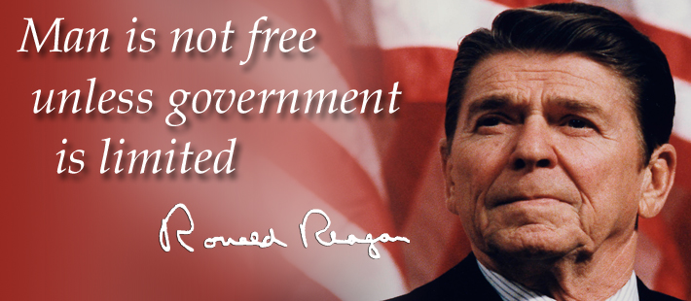

Slide 6
Power of the Monarch
William of Normandy
  conquers England – 1066
  made nobles swear oath of loyalty to the king
  created a strong, centralized monarchy

Slide 7
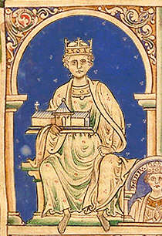
Henry II
  believed that expanding the power of the royal courts expanded the king’s power
    Royal judges, sheriffs and commisioners drilled Englishmen of all classes in the procedures of royal government & law
  acted with almost absolute power as he devised procedures to:
    collect taxes
    raise military forces
    keep records
    police the countryside
    administer justice

Slide 8
Magna Carta
growing tension related to the king’s power
  King John was abusing power in foreign policy
    He had failed in recent years in contests with powerful opponents beyond England, including a defeat by Philip II of France
    He lost a policy conflict with Innocent II, the most powerful pope of medieval Christendom
1215 – King John was forced to put his seal on the Magna Carta

Slide 9
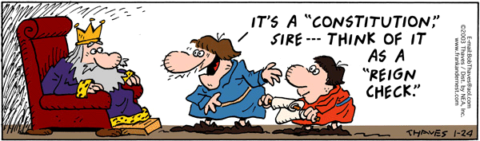

Slide 10
perhaps the most important early example of a written statement of law
expressed the idea that the monarch must accept established rules of law

Slide 11
Concepts
  freedom of the Church
  hear petitions from the barons
  freedom from quartering troops
  cannot seize land to pay for debts
  due process
  speedy trial and right to witnesses
  cannot issue extreme punishments

Slide 12
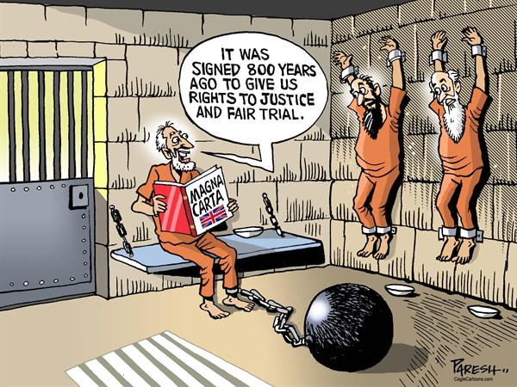

Slide 13
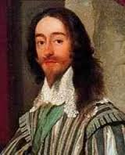
Petition of Right
Charles I
  eliminated Parliament
  began abusing power
House of Commons member Sir Edward Coke drafted a list of complaints
king was forced to sign the Petition of Right

Slide 14
Concepts
  Parliament must give consent to tax
  due process
  protection from land seizure
  imprisonment without probable cause was forbidden
  quartering of troops was prohibited
  trial by jury
  protection from unjust punishments or fines

Slide 15
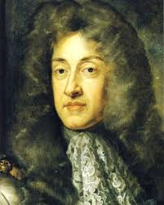

English Bill of Rights
rule of James II
Glorious Revolution effects
  Parliament destroyed the divine right theory of kingship
  was a triumph for the purity of constitutional law

Slide 16
Concepts
  Parliament has the right to levy taxes
  free exercise of religion
  right to assemble peacefully
  right to bear arms
  protection of property
  protection of the rights of the accused

Slide 17
 | RIGHT | RIGHT | RIGHT | RIGHT | RIGHT | RIGHT | RIGHT
Bill of Rights (1791) | 1st: religion, speech, press, assembly, petition | 2nd: keep & bear arms | 3rd: freedom from quartering troop | 4th: search & seizure rights | 5th: due process rights | 6th: fair trial rights | 8th: freedom from cruel & unusual punishment
Magna Carta (1215)
Petition of Right (1621)
English Bill of Rights (1688)

Slide 18
 | RIGHT | RIGHT | RIGHT | RIGHT | RIGHT | RIGHT | RIGHT
Bill of Rights (1791) | 1st: religion, speech, press, assembly, petition | 2nd: keep & bear arms | 3rd: freedom from quartering troop | 4th: search & seizure rights | 5th: due process rights | 6th: fair trial rights | 8th: freedom from cruel & unusual punishment
Magna Carta (1215)
Petition of Right (1621)
English Bill of Rights (1688)

Slide 19
 | RIGHT | RIGHT | RIGHT | RIGHT | RIGHT | RIGHT | RIGHT
Bill of Rights (1791) | 1st: religion, speech, press, assembly, petition | 2nd: keep & bear arms | 3rd: freedom from quartering troop | 4th: search & seizure rights | 5th: due process rights | 6th: fair trial rights | 8th: freedom from cruel & unusual punishment
Magna Carta (1215)
Petition of Right (1621)
English Bill of Rights (1688)

Slide 20
 | RIGHT | RIGHT | RIGHT | RIGHT | RIGHT | RIGHT | RIGHT
Bill of Rights (1791) | 1st: religion, speech, press, assembly, petition | 2nd: keep & bear arms | 3rd: freedom from quartering troop | 4th: search & seizure rights | 5th: due process rights | 6th: fair trial rights | 8th: freedom from cruel & unusual punishment
Magna Carta (1215)
Petition of Right (1621)
English Bill of Rights (1688)

Slide 21
 | RIGHT | RIGHT | RIGHT | RIGHT | RIGHT | RIGHT | RIGHT
Bill of Rights (1791) | 1st: religion, speech, press, assembly, petition | 2nd: keep & bear arms | 3rd: freedom from quartering troop | 4th: search & seizure rights | 5th: due process rights | 6th: fair trial rights | 8th: freedom from cruel & unusual punishment
Magna Carta (1215)
Petition of Right (1621)
English Bill of Rights (1688)

Slide 22
 | RIGHT | RIGHT | RIGHT | RIGHT | RIGHT | RIGHT | RIGHT
Bill of Rights (1791) | 1st: religion, speech, press, assembly, petition | 2nd: keep & bear arms | 3rd: freedom from quartering troop | 4th: search & seizure rights | 5th: due process rights | 6th: fair trial rights | 8th: freedom from cruel & unusual punishment
Magna Carta (1215)
Petition of Right (1621)
English Bill of Rights (1688)

Slide 23
 | RIGHT | RIGHT | RIGHT | RIGHT | RIGHT | RIGHT | RIGHT
Bill of Rights (1791) | 1st: religion, speech, press, assembly, petition | 2nd: keep & bear arms | 3rd: freedom from quartering troop | 4th: search & seizure rights | 5th: due process rights | 6th: fair trial rights | 8th: freedom from cruel & unusual punishment
Magna Carta (1215)
Petition of Right (1621)
English Bill of Rights (1688)

Slide 24
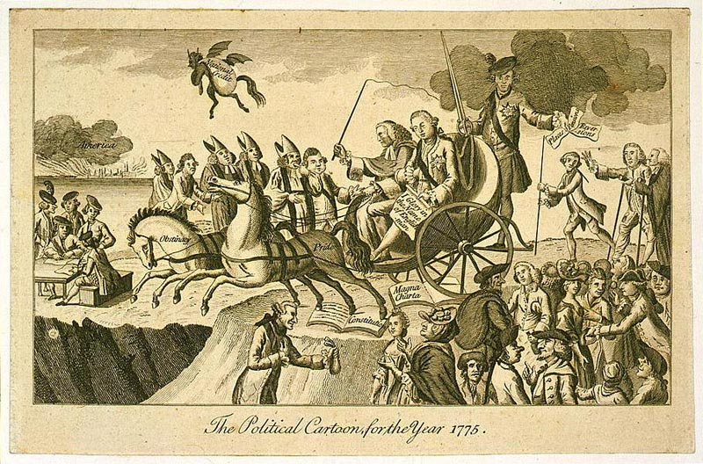
Lord Mansfield (with whip) and George III are in an open chaise being pulled towards a chasm which represents war with the American colonies by 2 horses labeled ‘Pride’ and “Obstinacy’. These animals are trampling all over the Magna Carta and the Constitution as America burns in the distance. This cartoon appeared in Westminster Magazine in 1775.

