Slide 1
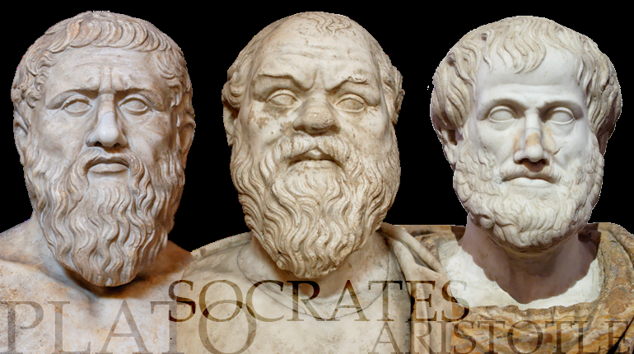
Influences on the
Development of
American Democracy

Slide 2
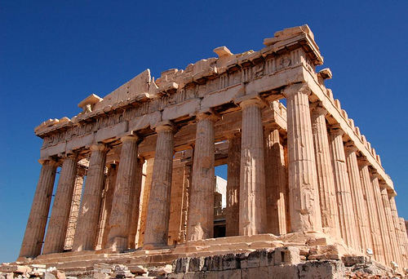
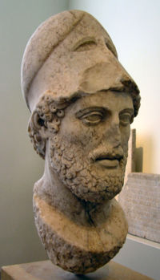
Pericles - Father of Democracy
Reign 461 – 429 BC
Democracy
will of the people

Slide 3
established The Assembly
composed of elected officials
had the power to
make laws
war decisions
foreign policy

Slide 4
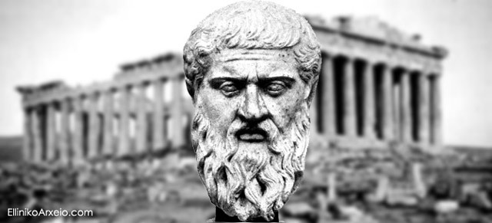
Plato
student of Socrates
stressed gender equality

Slide 5
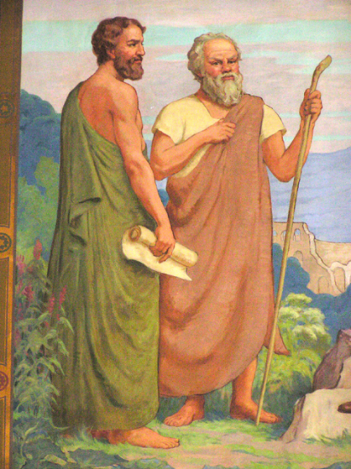
believed there are 3 groups of society
Philosopher Kings – enlightened rulers
Warriors – represented courage
Masses – represented desire

Slide 6
The Republic
established The Allegory of the Cave
claimed knowledge is duty
physical world is misleading, and therefore not what you should base truth upon

Slide 7
constant struggle for humans
discovering the reality of the world while balancing what you know to be true with what the physical world is showing you to be true
https://www.youtube.com/watch?v=c5v377erIkc

Slide 8
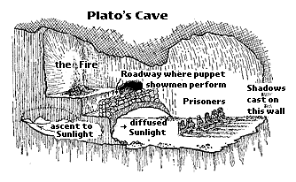

Slide 11
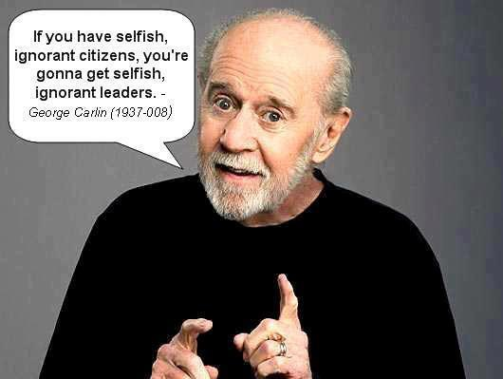

Slide 12
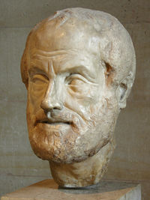
Aristotle
Plato’s student
believed “People can be good independent of society”
citizens can only exist in the social structure of society

Slide 13
believed there are 3 types of government
Autocracy – rule by one (Tyranny)
Oligarchy – rule by few (Aristocracy)
Democracy – rule by many (Constitutional)

Slide 14
Politics
formed Western political thought
claimed ideal society comes from education
the poor have the power
in a democracy majority is supreme

Slide 15
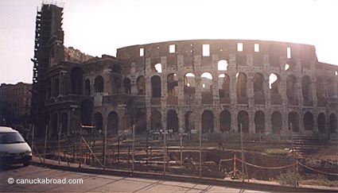
Rome
Twelve Tables – Rome’s first code of laws
influence
innocent until proven guilty (Amendments 5 & 6)
defend oneself in front of a judge (Amendments 5 & 6)
allowed the worship of native Gods and new Gods (Amendment 1)

