Slide 1
Indigenous Sacred Ways

Slide 2
“All animals have power, because the Great Spirit dwells in all of them, even a tiny ant, a butterfly, a tree, a flower, a rock. The modern, white man’s way keeps that power from us, dilutes it. To come to nature, feel its power, let it help you, one needs time and patience for that....You have so little time for contemplation....It lessens a person’s life, all that grind, that hurrying and scurrying about.
~Lame Deer, Lakota Nation

Slide 3
“The wicasa wakan [holy man] wants to be by himself. He wants to be away from the crowd, from everyday matters. He likes to meditate, leaning against a tree or rock, feeling the earth move beneath him, feeling the weight of that big flaming sky upon him....Closing his eyes, he sees many things clearly. What you see with your eyes shut is what counts....”
~Lame Deer, Lakota Nation

Slide 4
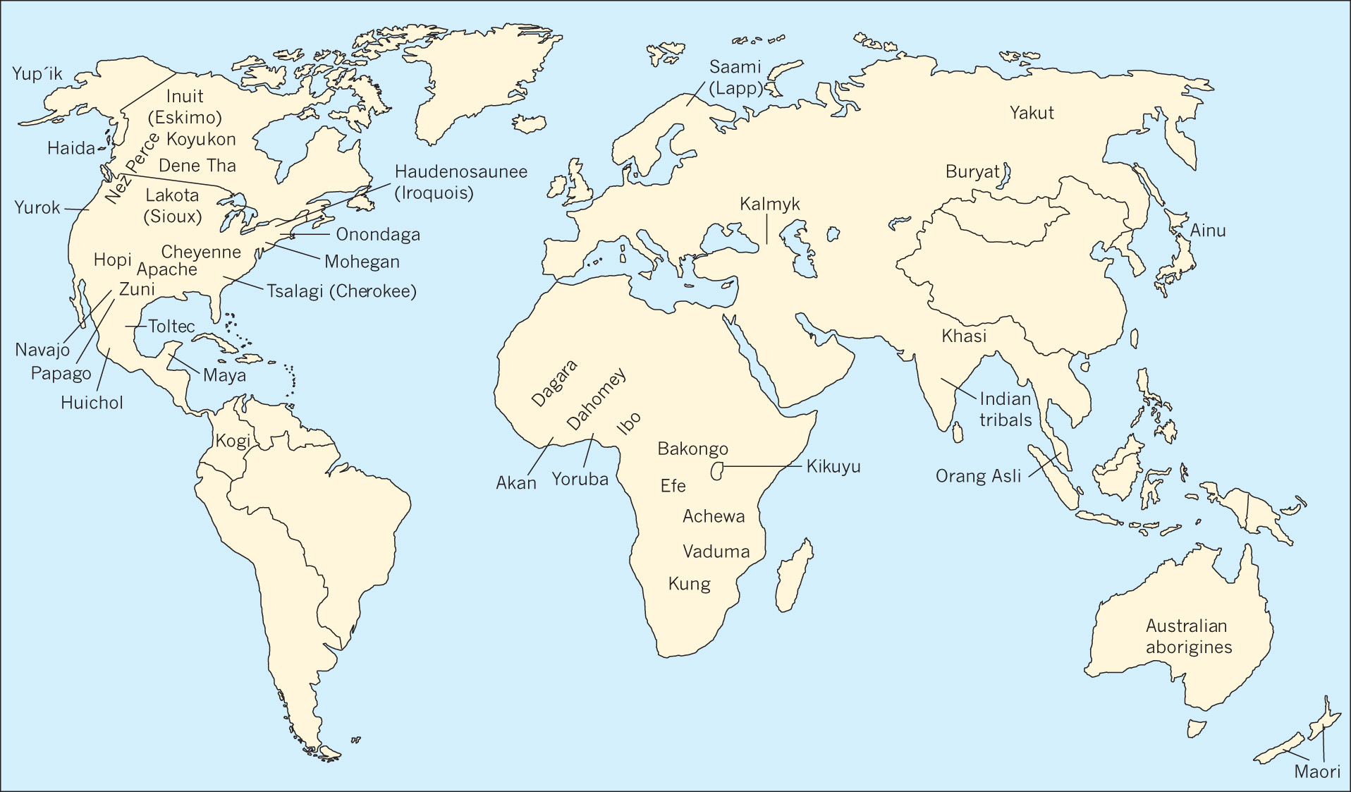
Approximate distribution of indigenous groups in Chapter 2

Slide 5
Understanding Indigenous Sacred Ways
Have traditionally been little understood by outsiders
Many traditions have been practiced in secret—hidden from outsiders—hindering scholarly study

Slide 6
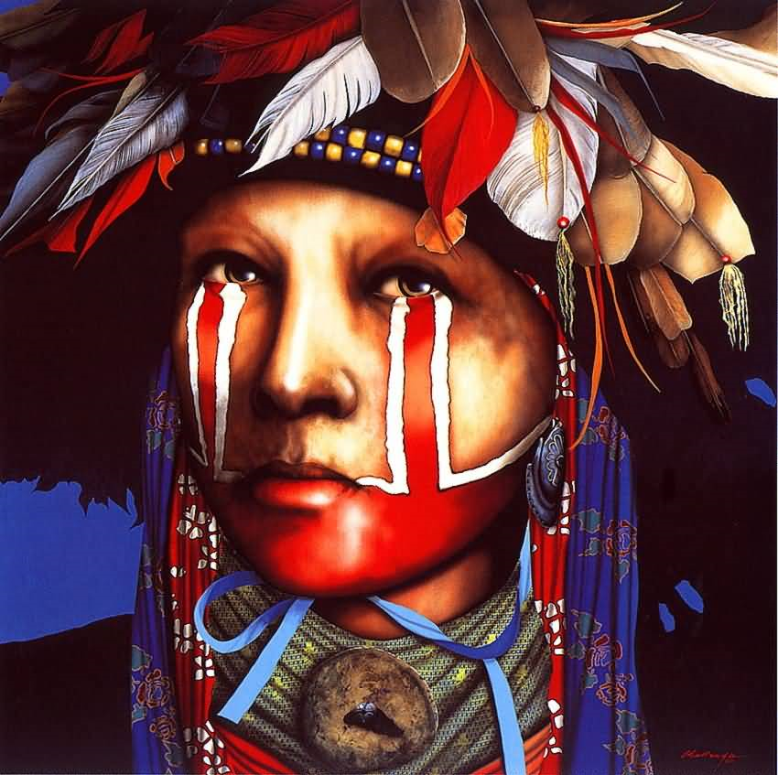
May be seen as a lifeway
Common ground between these religions and those on the outside is emerging

Slide 7
Cultural Diversity
Although focus is on common characteristics of indigenous religions, these religions are quite distinct

Slide 8
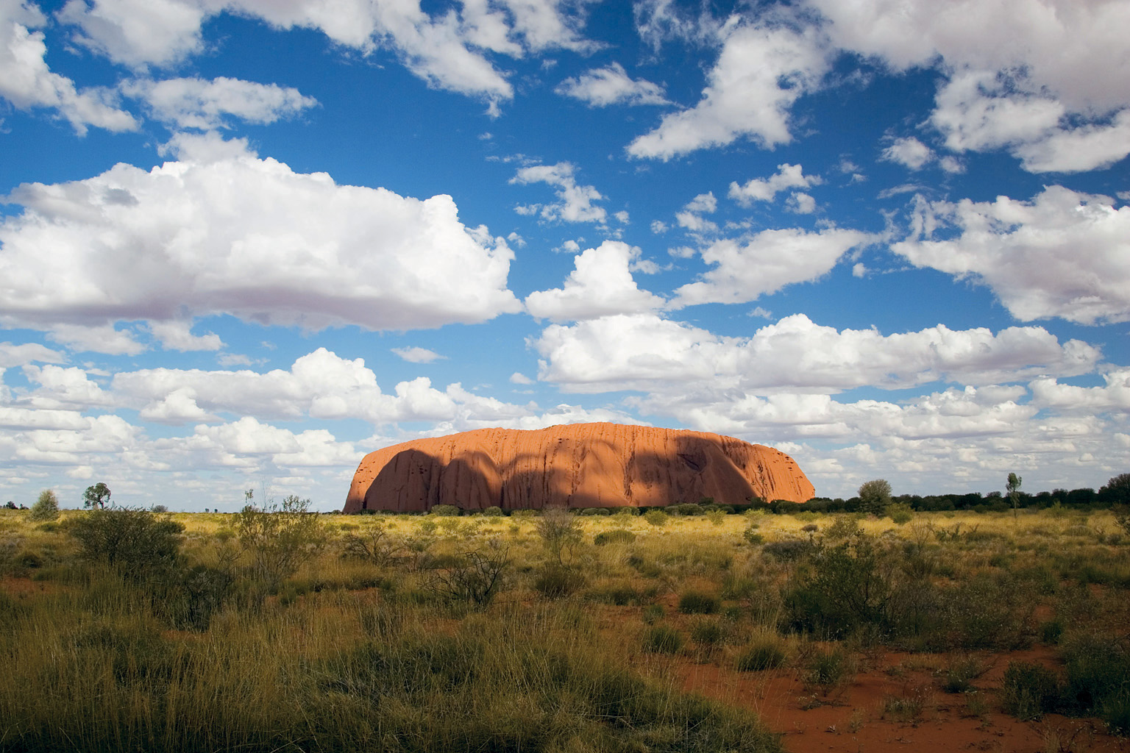
Uluru (Ayers Rock) is sacred to Australian Aborigines

Slide 9
Circle of Right Relationships
For many indigenous peoples, everything in the cosmos is intimately interrelated
Sometime represented as a circle, which has no beginning, no end

Slide 10
Cosmos is thought to contain divinities, spirits, and ancestors
All aspects of the tangible world are imbued with spirit
Common theme in indigenous lifeways is developing an appropriate relationship with spiritual energy

Slide 11
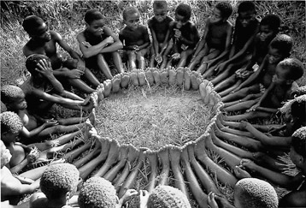
Efe children in Democratic Republic of Congo “circle game”

Slide 12
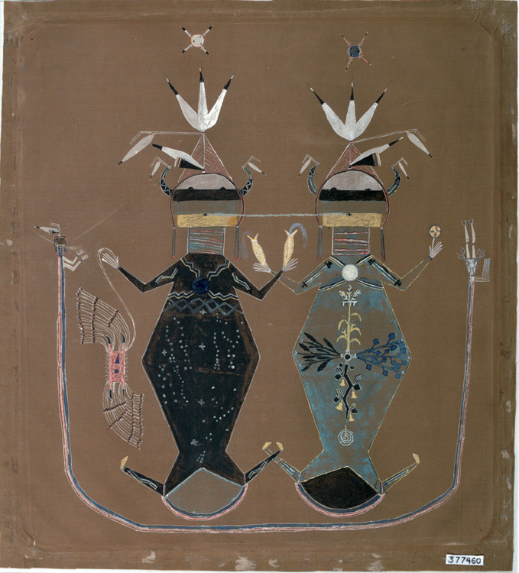
Navajo sand-painting
shows Father Sky with constellations and the Milky Way forming his body and Mother Earth with the four sacred plants, squash, beans, tobacco, and corn forming hers.

Slide 13
Spiritual Specialists
In hunting and gathering tribes religion is private; individuals have direct access to the unseen
However, the world of the spirit is thought to be dangerous
Interacting with spirit world best left to those specially trained for it

Slide 14
Storytellers
Common role because traditions are oral rather than written
What is held in memory cannot be physically destroyed but if all the storytellers die the knowledge is lost

Slide 15
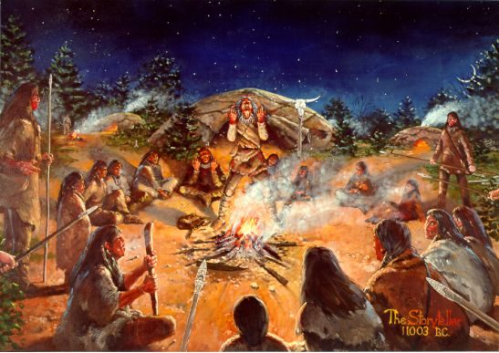
In Africa poets are considered “technicians of the sacred”
Other roles: drummers, tricksters, sacred clowns, secret societies, priests/priestesses

Slide 16
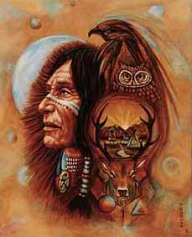
Mystical Intermediaries
Shaman is a generic term used by scholars for those who offer themselves as mystical intermediaries
Shamanic methods are extremely ancient

Slide 17
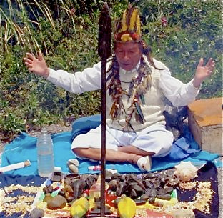
The shaman is often a healer or a helper to society
May be hereditary or recognized as a special gift

Slide 18
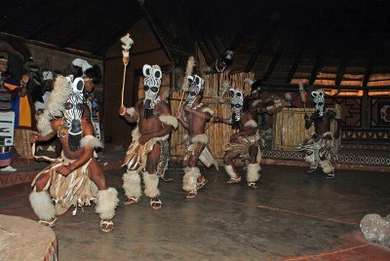
Group Observances
Humans can help maintain the natural harmony of the world by practicing ritual observances
These rituals are community-centered

Slide 19
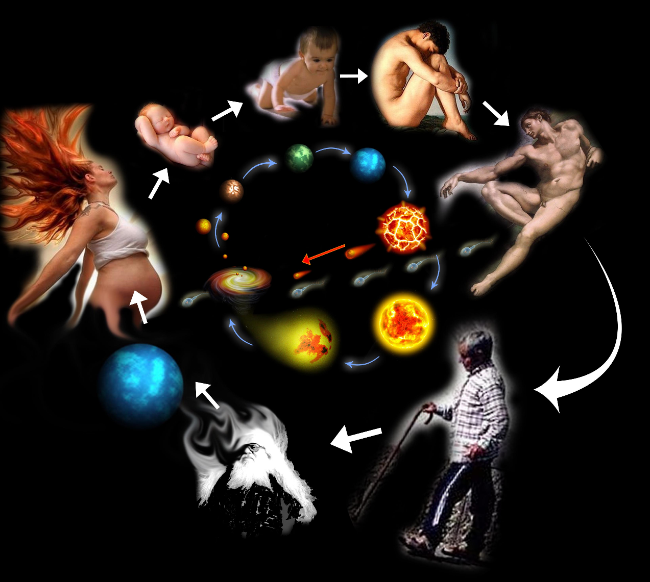
Some follow the major points of passage in the human life cycle
Birth
Marriage
Naming
Death
Puberty

Slide 20
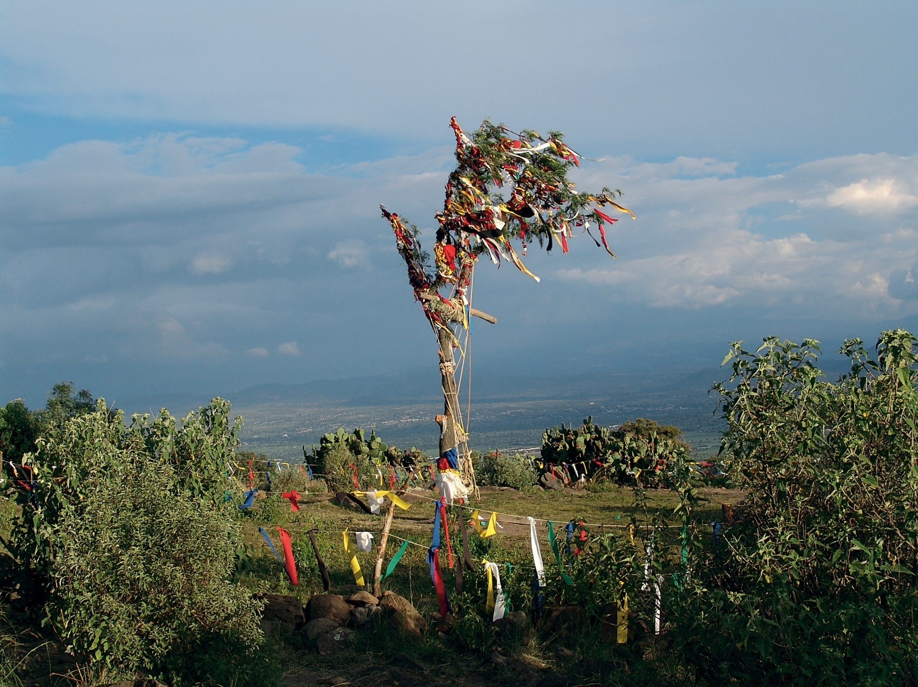
Prayer cloths on a sacred tree at a Sun Dance in Mexico

Slide 21
Individual Observance
Balances the communal dimension of ritual observance
Important for individuals to experience a personal connection with the realm of the spirits
Undergoing a vision quest (usually at puberty) is a common means of access to the other world

Slide 22
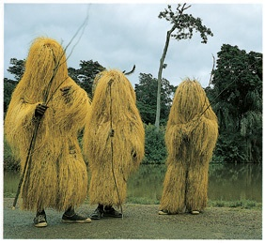
The gods
and the spirits of the dead appear in costumed initiates in West Africa.

Slide 23
Contemporary Issues
Central concern: the near obliteration of these responses to the sacred world
Many indigenous people have been displaced by development

Slide 24
Indigenous world view that reveres all creation, recognizes the circle of life, and honors the human relationship with mother earth may be necessary to stop the present ecological destruction of the planet

