Slide 1
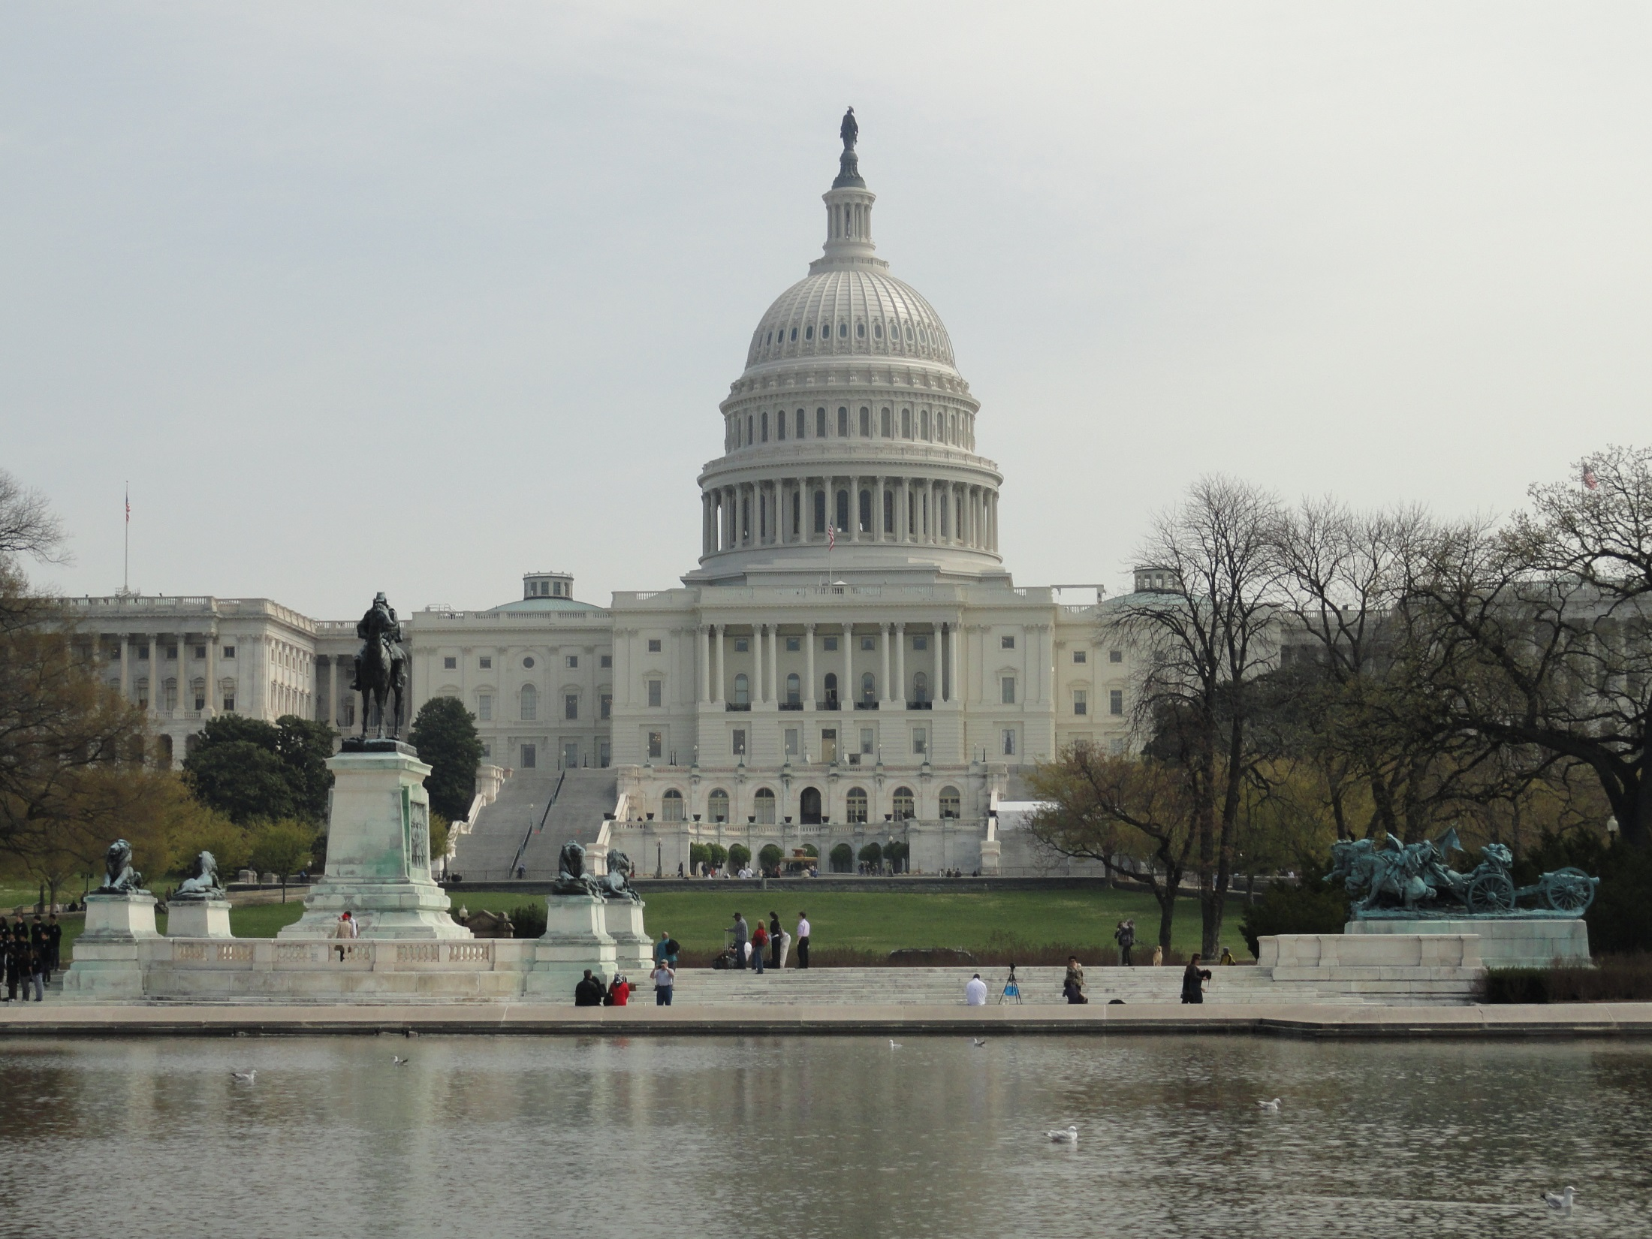

How a Bill
Becomes a Law

Slide 2

“The duty of the legislative branch is to make the laws. Congress is the only branch of the U.S. government that existed prior to the Constitution”
~ Linda Monk, The Words We Live By

Slide 3
“As good government is an empire of laws, how shall your laws be made? In a large society, inhabiting an extensive country, it is impossible that the whole should assemble to make laws. The first necessary step, then, is to depute power from the many to a few of the most wise and good.”
~ John Adams

Slide 4
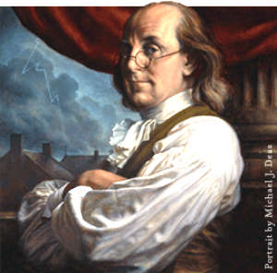
“Laws too gentle are seldom obeyed; too severe, seldom executed.”
~ Ben Franklin

Slide 5
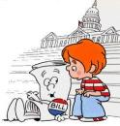

Types of Bills & Resolutions
private bills
  deals w/ individual people or places

Slide 6
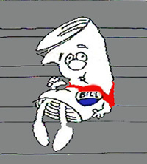
public bills
  deals with general matters
  applies to the entire nation

Slide 7


Resolutions
simple resolution – affects only 1 house
  addresses procedural rules

Slide 8
joint resolution – passed by both houses
  a device for proposing constitutional amendments or other matters
  has the force of law

Slide 9
concurrent resolutions – requires attention from both houses
  no law is needed
riders – provision on a subject other than what is covered in a bill

Slide 10
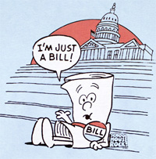
https://www.youtube.com/watch?v=Otbml6WIQPo

Slide 11

Introducing a Bill
bills are proposed
committee action
committee hearings
reporting a bill

Slide 12
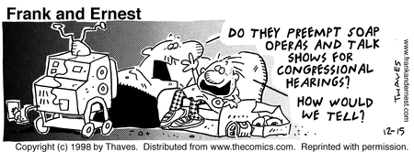

Slide 13
Floor Action
debating & amending bills
voting on bills

Slide 14
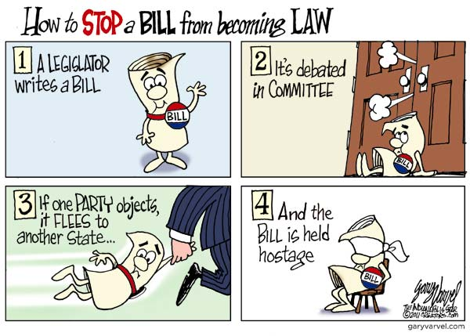

Slide 15


Slide 16


Slide 17
Final Steps
Conference Committee Action

Slide 18
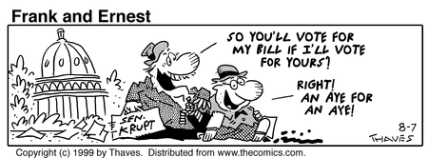

Slide 19
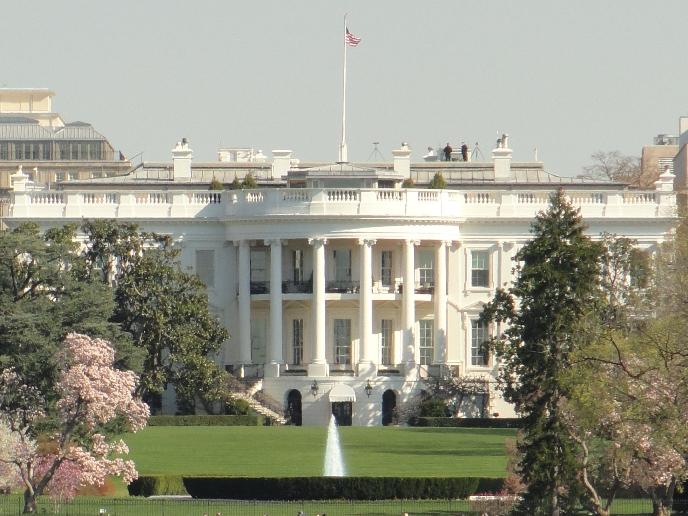

Presidential Action
  signs & makes official
  veto
  line-item veto
  congressional override of a veto

Slide 20
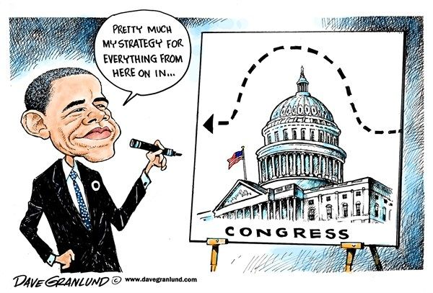

Slide 21
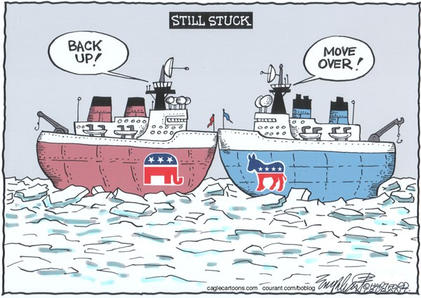

Slide 22

Taxing & Spending Bills
House’s power
  Revenue bills must be initiated in the House
  Ways and Means Committee

Slide 23

Senate’s power
  amendments
appropriating money
  authorization bills
  appropriations bills

