Slide 2
“Ancient Rome declined because it had a Senate, now what's going to happen to us with both a House and a Senate?”
~ Will Rogers

Slide 3
“Government is not reason; it is not eloquent; it is force. Like fire, it is a dangerous servant and a fearful master.”
~George Washington

Slide 4
Origins
Framers believed Congress should represent ALL the people

Slide 5
“It is crucial that members of Congress cast votes that are supportive of the values upon which our nation was founded: equality, freedom, and opportunity for all people.”
~ Joe Baca

Slide 6
House of Representatives
designed to
express the sentiments and viewpoints of diverse constituencies in electoral districts
permit frequent turnover if voters choose to replace representatives

Slide 7
Size & Terms
exact size of the House is currently at 435 members
Congress determines the number

Slide 8
The Constitution provides that the total number of seats in the House shall be apportioned (distributed) among the States on populations

Slide 9
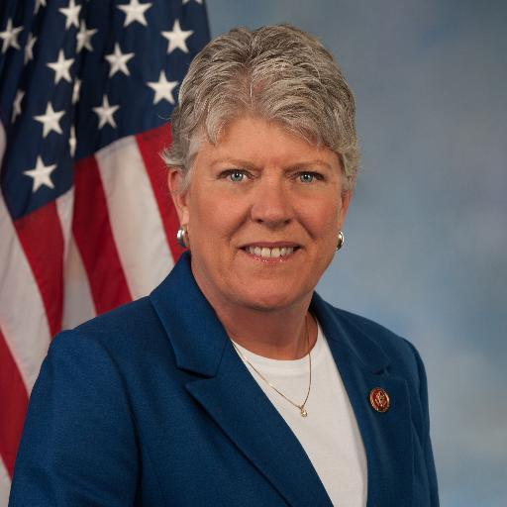
Currently
235 Democrats
199 Republicans
102 women
Speaker of the House: Nancy Pelosi (D) California

Slide 10
Reapportionment
Article I of the Constitution directs Congress to reapportion—redistribute—the seats in the House after each decennial census

Slide 11
The Reapportionment Act of 1929
set “permanent” size at 435 members
provided for “automatic reapportionment”

Slide 12
Districts & Gerrymandering
Districts that have unusual shapes or even defy description have sometimes been gerrymandered

Slide 13
Gerrymandering
drawing congressional districts to the advantage of the political party that controls the State legislature

Slide 14
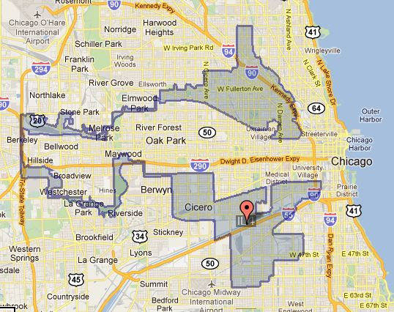

Slide 15
