Slide 1
Efficiency, Growth & Cost

Slide 2
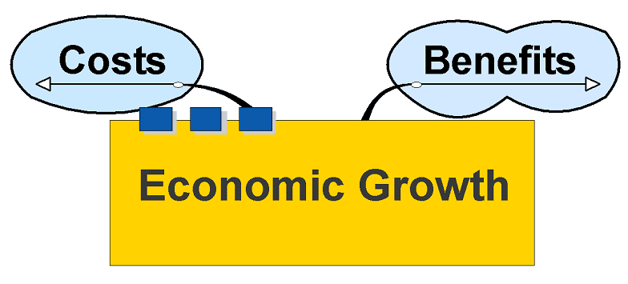
Economic Growth

Slide 3
Benefits

Slide 4
Benefits
Increases in economic growth should enable more of everything to be produced
Increases possibility of providing consumer goods for all

Slide 5
More consumer goods, etc. could be equated with an increase in living standards
Wealth generated may eventually ‘trickle down’ to those who are poor by means of income distribution – taxes and benefits, etc.

Slide 6
Improved standards of living associated with increase in the availability of luxury goods:
TVs
Fridges and freezers
Swimming pools, etc .
In addition:
Infrastructure – roads, rail, energy, water, communication networks
Health and education provision
All associated with a ‘decent’ standard of living

Slide 7
Improvement in Welfare
Welfare is improved by the provision of support services for those not necessarily able to help themselves Welfare includes:
Pensions
Benefits – sickness, disability, etc.
Support – maternity leave
Infrastructure – housing
Such welfare provision often funded through income redistribution - taxes

Slide 8
Welfare
Providing support for the elderly, homeless, orphaned and disadvantaged is something only wealthy countries can afford to any great extent.

Slide 9
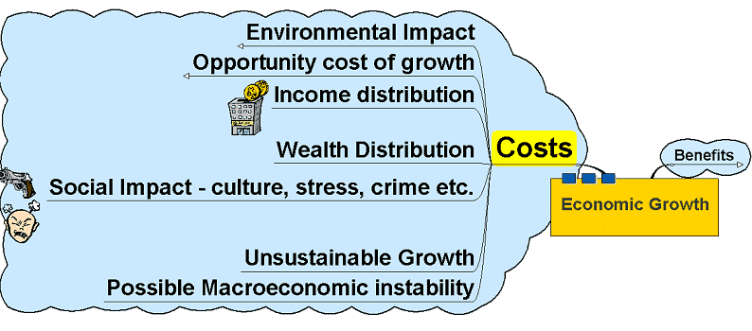
Costs

Slide 10
Costs
Economic growth can bring with it costs:
Not all income distributed equally
Wealth often in the hands of a few
‘Trickle down’ does not always seem to work in practice
Corruption may reduce redistribution effects
Growth funded in part by spending on weapons which do not benefit the population as a whole

Slide 11
Environmental problems
Expansion and growth brings with it the problems of pollution – often developing countries do not have the infrastructure to cope with the waste generated nor the legislation or regulation to influence those who produce it

Slide 12
Environmental Impact
Negative Externalities
Pollution – dumping of hazardous waste
Environmental degradation – over farming reduces productivity of the soil, deforestation, damage to eco-systems and reduction in biodiversity
Non-renewable resources

Slide 13
Opportunity Cost of Growth
Resource allocation
Consumer Goods?
Capital Goods?
Necessity of generating growth through allocating resources to the sources of growth – capital goods
Makes population poorer as fewer consumer goods initially available – often these consumer goods represent the basic essentials of life

Slide 14
Opportunity Cost of Growth
Capital Goods
Any attempt to increase the basis for wealth generation – by producing more capital goods that need to be used for such wealth generation – will mean a reduction in the number of consumer goods available (the opportunity cost). Such a reduction can be very damaging to a country already suffering a lack of basic essentials.
Production Possibility Frontier:
Assume initial output levels of C1 consumer goods and K1 capital goods – where C1 barely represents the essentials of life in a developing country – clean water, food, shelter, etc.
K2
Gain
Opportunity cost of K2 – K1 capital goods is C1 – C2 consumer goods sacrificed.
K1
Sacrifice
C2
C1
Consumer Goods

Slide 15
Growth and Production Possibility Frontiers
Capital Goods
1. Economic growth when a country is operating below capacity – more of both capital and consumer goods are made available as the economy moves from point A to point B
B
K2
A
K1
C1
C2
Consumer Goods

Slide 16
Growth and Production Possibility Frontiers
Capital Goods
B
2. Country operating at full capacity but discovers new resources or find ways of improving the efficiency of existing resources, for example, education of the population to improve the quality of human capital.
K2
A
K1
C1
C2
Consumer Goods

Slide 17
Growth and Production Possibility Frontiers
Capital Goods
3. Disproportionate shift in PPF caused by investment in resources suitable for producing certain types of goods – for example, investment from overseas may generate growth in the production of consumer goods as opposed to capital goods – is such investment of long term benefit to a developing country?
B
A
K2
K1
C1
C2
Consumer Goods

Slide 18
Growth and Production Possibility Frontiers
Capital Goods
4. Disproportionate shift in PPF as a result of investment in resources that favour generation of capital goods – may not initially seem to have major impact on the standard of living of the country but may have long term benefits in enabling more sustainable long term growth.
B
K2
A
K1
C1
C2
Consumer Goods

Slide 19
Issue: An Economy is Always in Transition
1700s – WWII: agrarian to a manufacturing economy
WWII – present: manufacturing to a service economy
Change in consumer demands as income increase combined with technological change increased productivity in the agricultural sector spurred on by competition

Slide 20
Resources shifted from agricultural uses to manufacturing sector
Changes in consumer demands and technological change in the informational sector, have led competitive markets to move from manufacturing goods to producing services.

Slide 21
Resources are shifting from manufacturing industries to service sectors
Market or laissez-faire versus command or planned economy
Capitalism and socialism and the mixed economy

Slide 22
Causes of Economic Growth
Increased number of resources
Investment
Growth in Labor Force
Increased productivity of resources:
Work Ethic
Technology
Education
Risk-taking and innovation

Slide 23
Social system that allows the efficient use of resources and promotes productivity
Market system and self-interest
Laws, property rights, and public order
Political and economic freedom

Slide 24
Production possibilities curve
Opportunity Cost
Computers (mill.)
Computers (mill.)
Attainable and unattainable production combinations
Possible combinations of computers and VCRs
A
A
Production possibilities curve (PPC)
B
Production possibilities curve (PPC)
B
F
unattainable
C
Points along PPC imply no unemployed resources and efficient production
C
Foregone output
E
D
inefficient
D

Slide 25
Law of increasing opportunity cost
Opportunity Cost
Computers (mill.)
A
A bowed outward PPC illustrates increasing opportunity costs
B
C
D

Slide 26
Economic growth & the PPC
Changes in the PPC
Computers (mill.)
E
Economic growth is illustrated by an outward shift in a nation’s PPC
F
G
C
PPC₀
PPC₁

Slide 27
Consumption trade-offs & growth
Economic Growth
Consumer goods (hamburgers)
Consumer goods (hamburgers)
United States
Japan
Next year's production possibilities
Next year's production possibilities
Japan's choice to favor capital goods (point A) will shift its future PPC farther out
The US choice to produce more consumer goods (point A) limits future production growth
A
PPC₀
PPC₀
PPC₁
This year's production possibilities
PPC₁
A
This year's production possibilities

