Slide 1

Developing Federalism

Slide 2

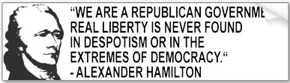
ENT

Slide 3

“In framing a government which is to be administered by men over men you must first enable the government to control the governed; and in the next place oblige it to control itself.” – James Madison

Slide 4
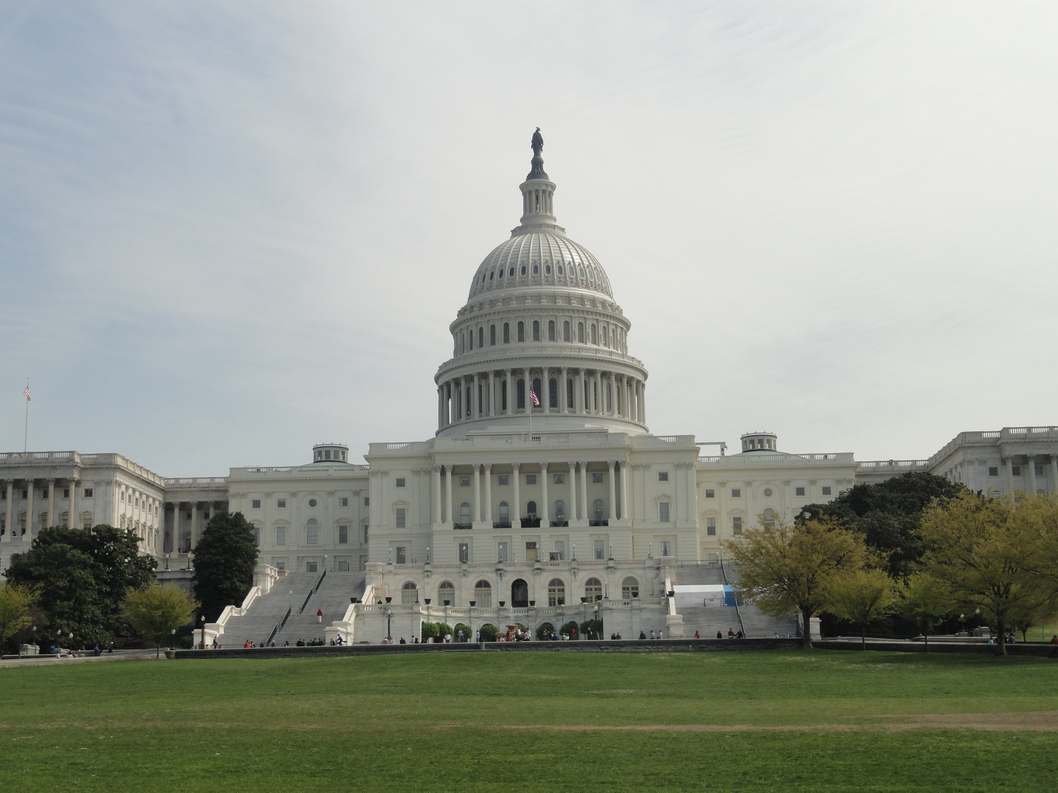
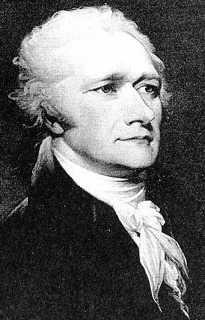
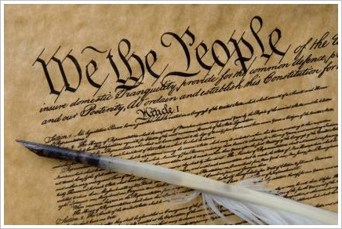
Nationalist Position
favors national action in dealing with problems

Slide 5
believe
  people, not states, created both governments
  expressed national powers should be expanded
  stands for all the people

Slide 6
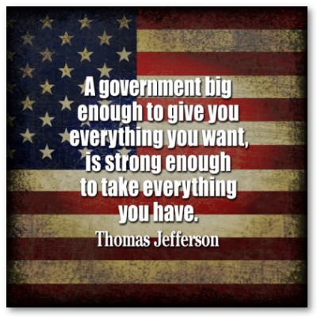

Slide 7
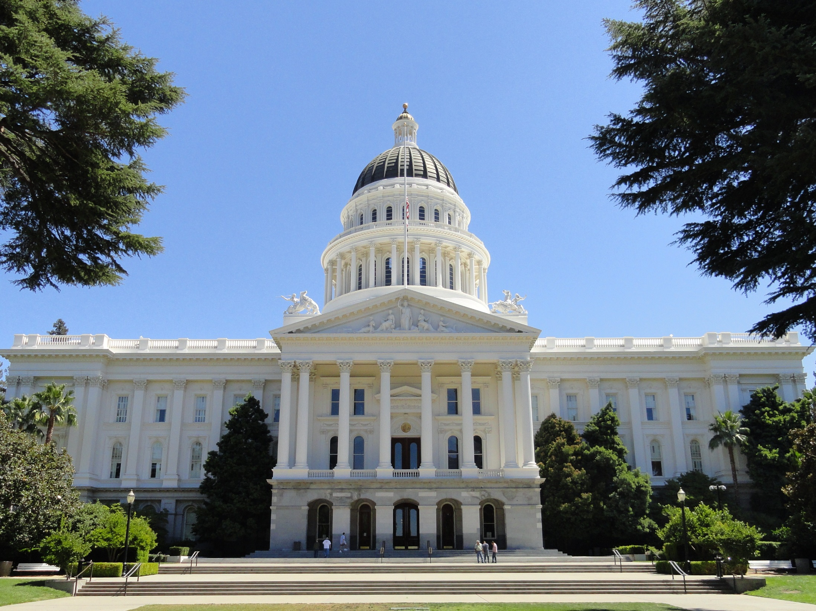


States' Rights Position
favors state and local action in dealing with problems

Slide 8
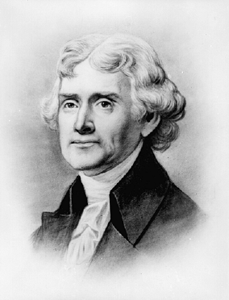
believe
  the Constitution is a compact among the states
  state governments are closer to the people

Slide 9
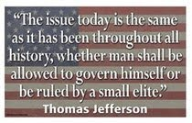

Slide 10
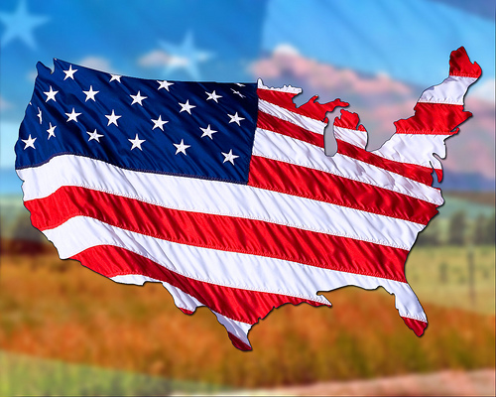
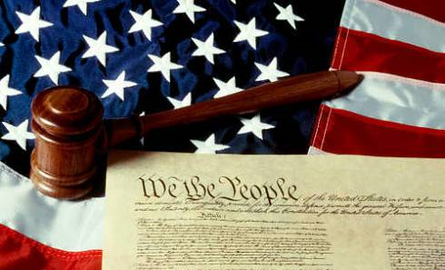
Growing National Government
expansion is based on 3 constitutional provisions
  war powers
  commerce power
  taxing power

Slide 11

Federal Aid to the States
politics & spending
  more federal aid means more federal control

Slide 12
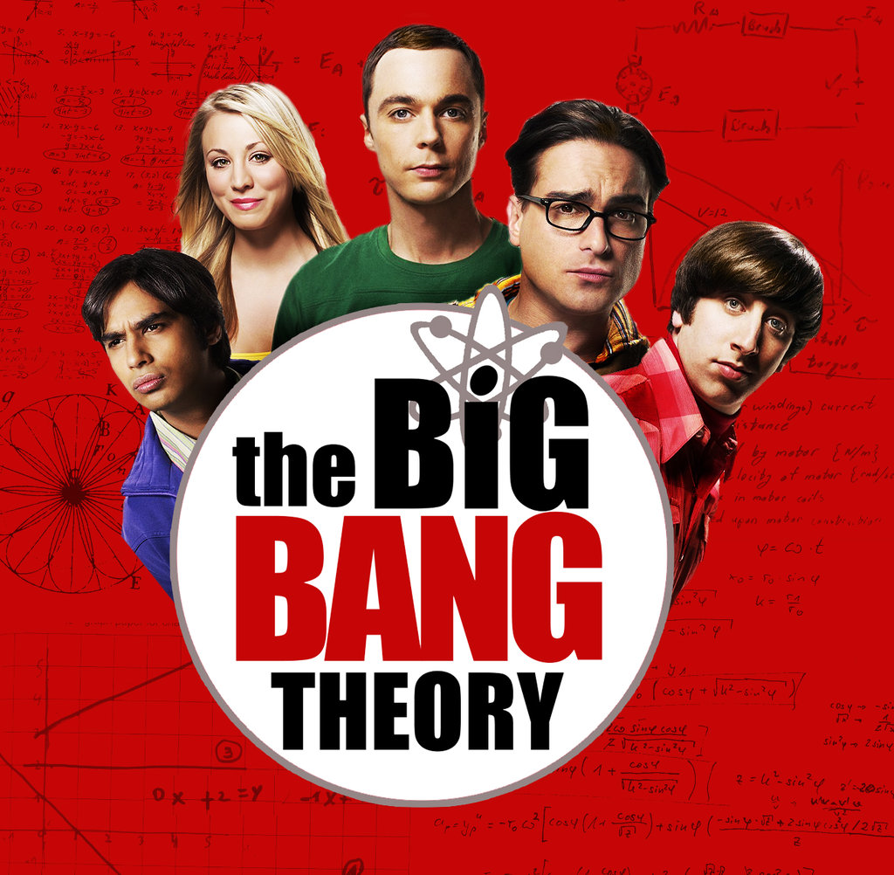
The Big Bang Theory - Sheldon and Penny Exchange Presents
  https://www.youtube.com/watch?v=FpGkLzGl1CI

Slide 13
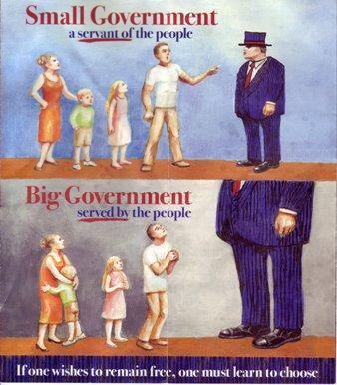

Slide 14
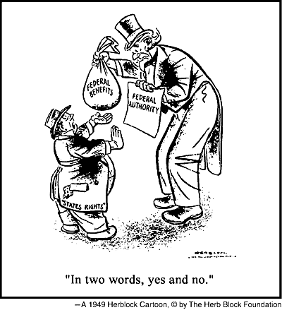

Slide 15
Increase in Federal Power
Great Depression
  changed federalism profoundly
  grant-in aid programs
    federal grants to states to help with programs

Slide 16
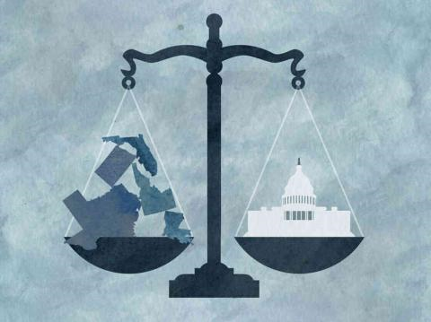
shifting responsibilities
  “New Federalism”
    shift more power to the states

Slide 17
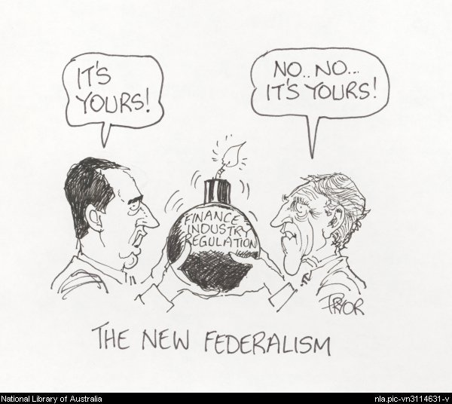

Slide 18
Federalism & Public Policy
public policy
  course of action the government takes in response to some issue or problem

Slide 19
