Slide 1
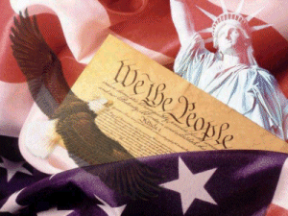
CONSTITUTION

Slide 2
Why a Constitution?
Citizens need to know what to expect from government
a constitution is the solution to that problem
under the Articles of Confederation the state laws were insufficient

Slide 3
We, the people of the United States, in order to form a more perfect union, establish justice, ensure domestic tranquility, provide for the common defense, promote the general welfare, and secure the blessings of liberty for ourselves and our posterity do hereby ordain and establish this Constitution for the United States of America. ~The Preamble to the Constitution

Slide 4
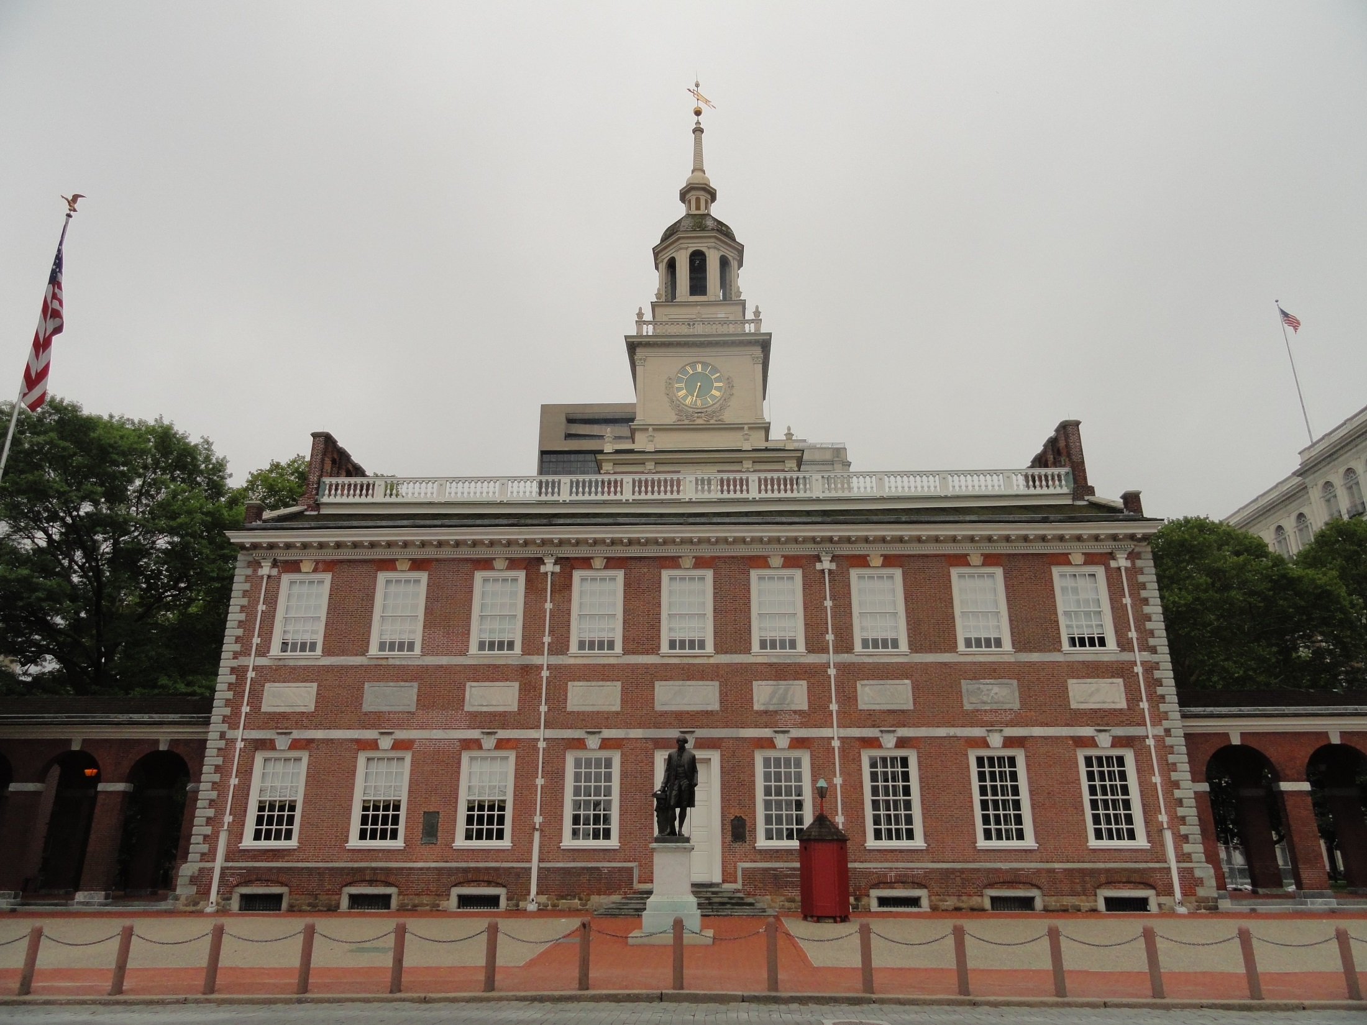
6 Major Principles
Popular Sovereignty
rule by the people
Federalism
power is divided between national & state governments

Slide 5
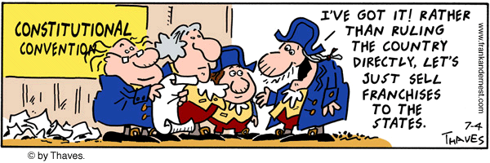

Slide 6
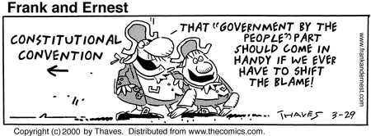

Slide 7
Separation of Powers
each branch has specific responsibilities
Madison was concerned with the existence of factions in government
Liberty is the cause of factions
Federalist 10 – Best way to control factions was to extend the sphere of government over a sufficiently large territory to prevent one entity from having “undue influence”

Slide 8
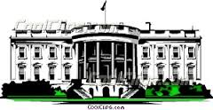
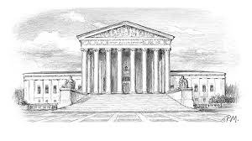
Legislative Branch
Deliberation
Judicial Branch
Impartiality
Executive Branch
Energy

Slide 9
Checks & Balances
“If angels were to govern men, neither external nor internal controuls on government would be necessary.” – James Madison
It was necessary to devise structures in the federal government to prevent excessive concentrations of power
each branch exercises some control over the others

Slide 10
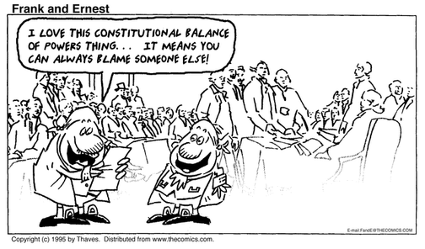

Slide 11
Judicial Review
the power of the courts to declare constitutionality of laws
Federalist 78 firmly established judicial review prior to Marbury v Madison
Intention was to protect the “weakest of the 3 departments” of government

Slide 12
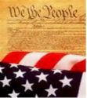
Limited Government
limits the actions of government by specifically listing powers it does & does not have

Slide 13
Bill of Rights

Slide 14
No Declaration of Rights???
Fighting for the BOR is the lasting legacy of the Anti-Federalist critics
The urgent call for a bill of rights rose just days before the convention closed
The Federalists preferred the state constitutions as opposed to a declaration of rights

Slide 15
Massachusetts was the first state to append a list of individual rights
The Federalists agreed out of fear of rejection
Hamilton opposed it in Federalist 38

Slide 16
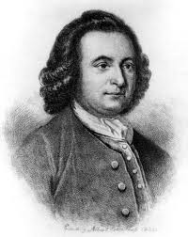
“The laws of the general government being paramount to the laws and constitutions of the several states, the declarations of rights in the separate states are no security.” – George Mason

Slide 17
“There is no Declaration of any kind, for preserving the Liberty of the Press, or the Tryal by Jury in Civil Causes; nor against the Danger of standing Armys in time of Peace.” – George Mason

Slide 18
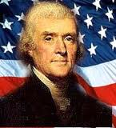
“A bill of rights is what the people are entitled to against every government on earth, general or particular, and what no just government should refuse or rest on interference.” – Thomas Jefferson

Slide 19
