Slide 1
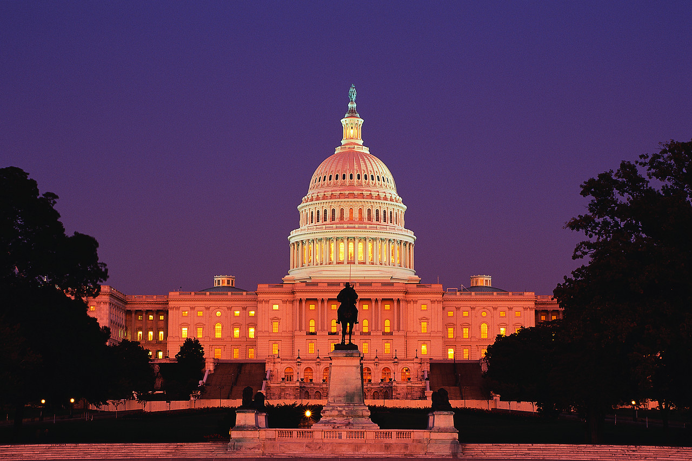

Congressional Powers

Slide 2



Slide 3
out of many, one

Slide 4
out of many, one
Peace

Slide 5
out of many, one
Peace
War

Slide 6
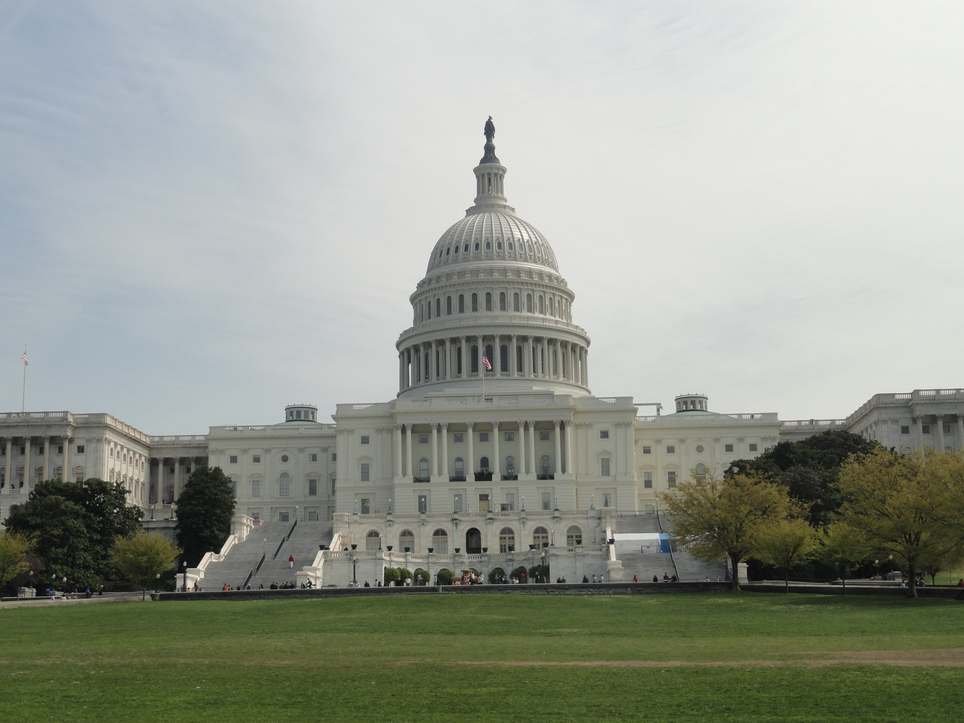
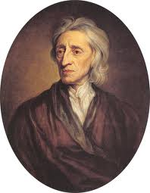


What are Congress's Constitutional Powers?
John Locke believed that the legislature is the most powerful branch of government because it makes laws

Slide 7

out of mistrust of any concentration of political power, the Framers carefully limited Congress’s powers

Slide 8



Slide 9
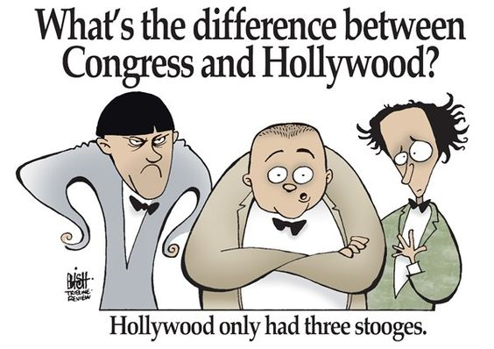

Slide 10
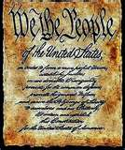
Enumerated Powers
expressed powers of Congress listed in the Constitution
regulation of commerce
  manufacturing
  child labor
  wages & work hours
  labor unions

Slide 11
Senate must give president consent for
  treaties
  ambassador appointments
  Supreme Court justice appointments
Congress has power to create lower federal courts

Slide 12

Congress can admit new states and adopt all rules and regulations respecting U.S. properties and territories

Slide 13
Congress can
  propose constitutional amendments
Congress can declare war
  create & maintain a military

Slide 14
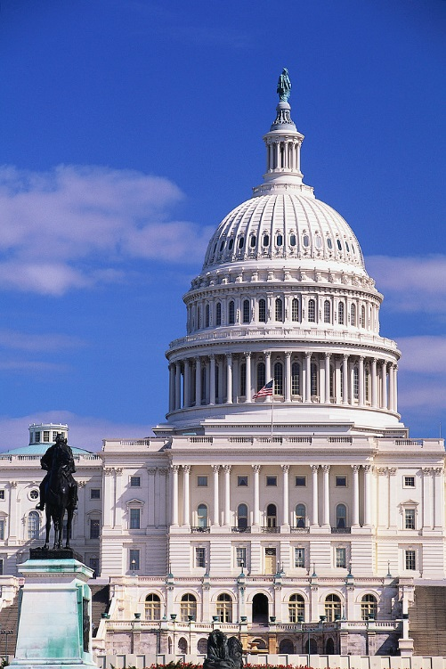

Implied Powers
Necessary and Proper Clause
  Congress can do whatever it takes to carry out its other powers
    draft

Slide 15

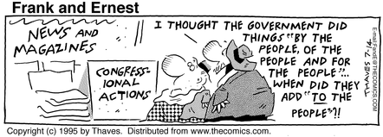

Slide 16
Inherent Powers
powers ingrained so deeply in an institution that they need not be stated
  right to conduct investigations and compel testimony

Slide 17

Powers Denied
writ of habeas corpus
bills of attainder
ex post facto laws

Slide 18

Legislative Powers
Taxing & Spending Power
  revenue bills start in the HOR
  appropriations bills
    authorizes the spending of money

Slide 19
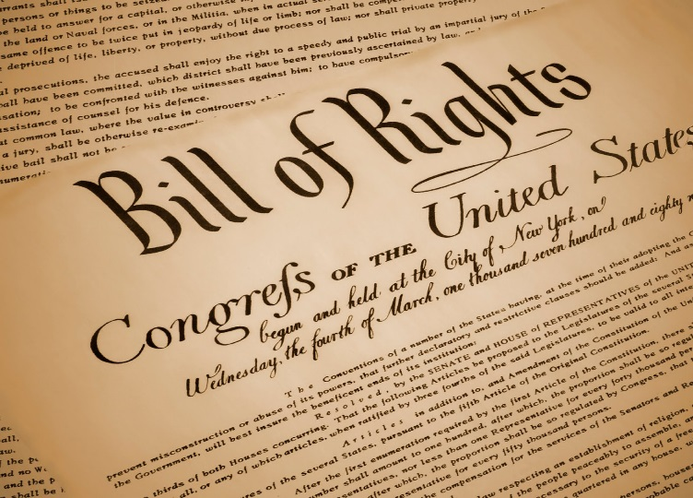
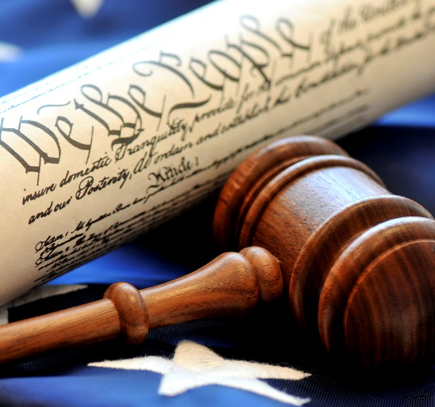
Nonlegislative Powers
Choose a Prez
  20th & 25th Amendments
removal power

Slide 20


Congress & da Prez
cooperation & conflict exists
  checks & balances
    legislative veto
    line-item veto
  party politics
  differing political timetables

Slide 21
